Slide 1
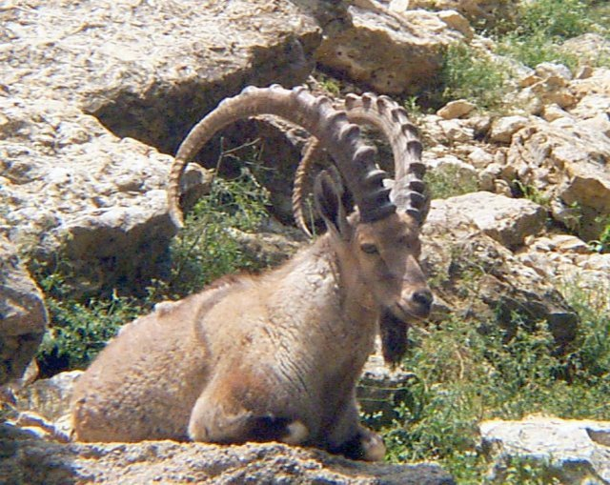
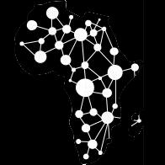
Understanding Africa’s Wildlife Heritage Through the Lens of Genome Data
Morris Agaba
Data Science Africa 2017 (DSA2017) Summer School and Workshop
17th – 21st July 2017 @NM-AIST, Arusha, Tanzania

Slide 2
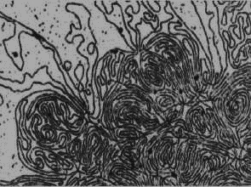
Data → Information → Life
When all things are considered, life reduces to the interaction of an information system with its environment to ensure its propagation and habitation in all liveable spaces.
Nucleic acid (e.g., DNA) is the chemical medium by which life’s information system is encoded in a string of 4 characters ‘A’, ‘C’, ‘G’, ‘T’.
The complete sequence of A C G and T’s of an organisms is its genome
The variation in the sequence of A C G and T in the genomes underlies the diversity of form and function of organisms

Slide 3
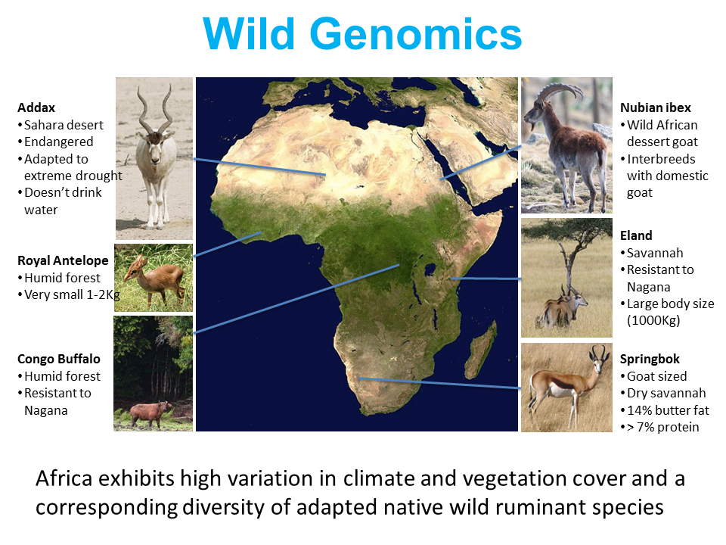
Wild Opportunities
Africa straddles the equator by several latitudes and presents diverse geophysical landscape and a corresponding diversity of flora and fauna

Slide 4
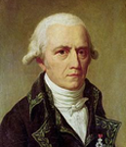
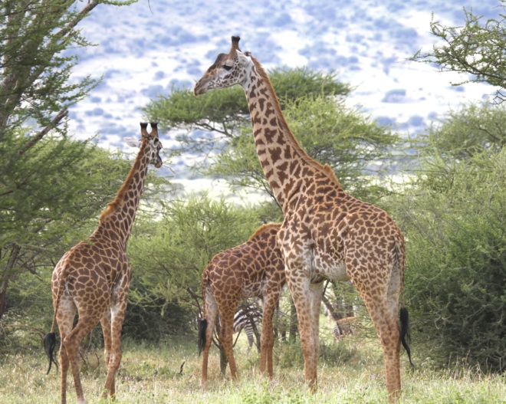
Doug Cavener
[t]he result of habit in the peculiar shape and size of the giraffe: little food and so that it is obliged to browse on the leaves of trees and to make constant efforts to reach them (Larmarck 1809)

Slide 5
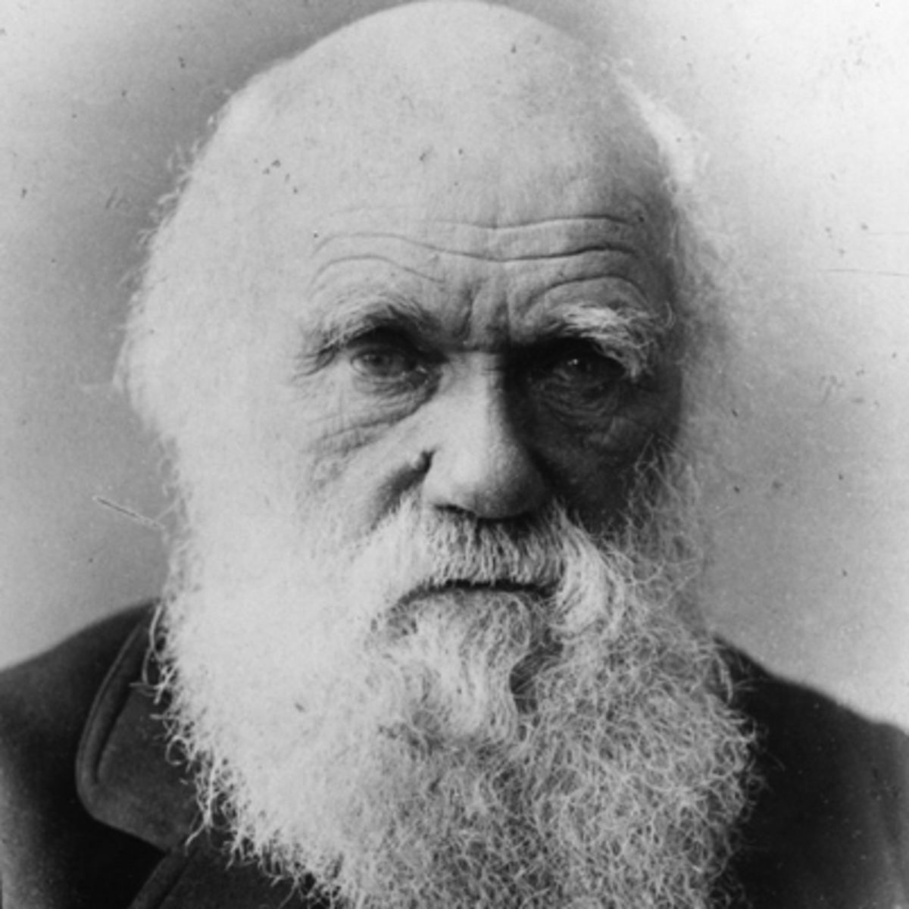
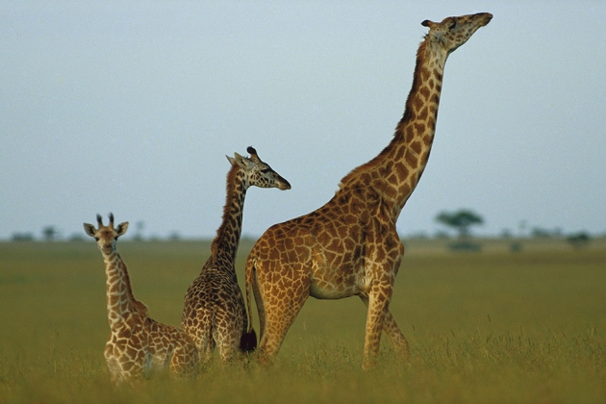
… [s]o under nature with the nascent giraffe the individuals which were the highest browsers, and were able during dearth to reach even an inch or two above the others, will often have been preserved …. (Darwin 1872)

Slide 6
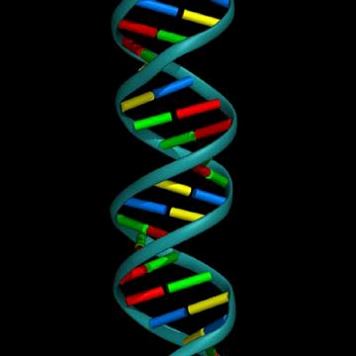
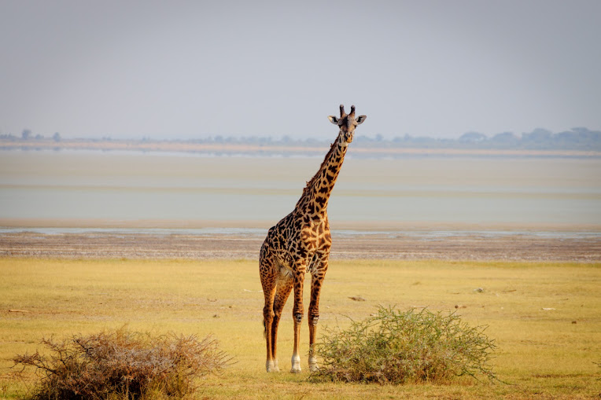
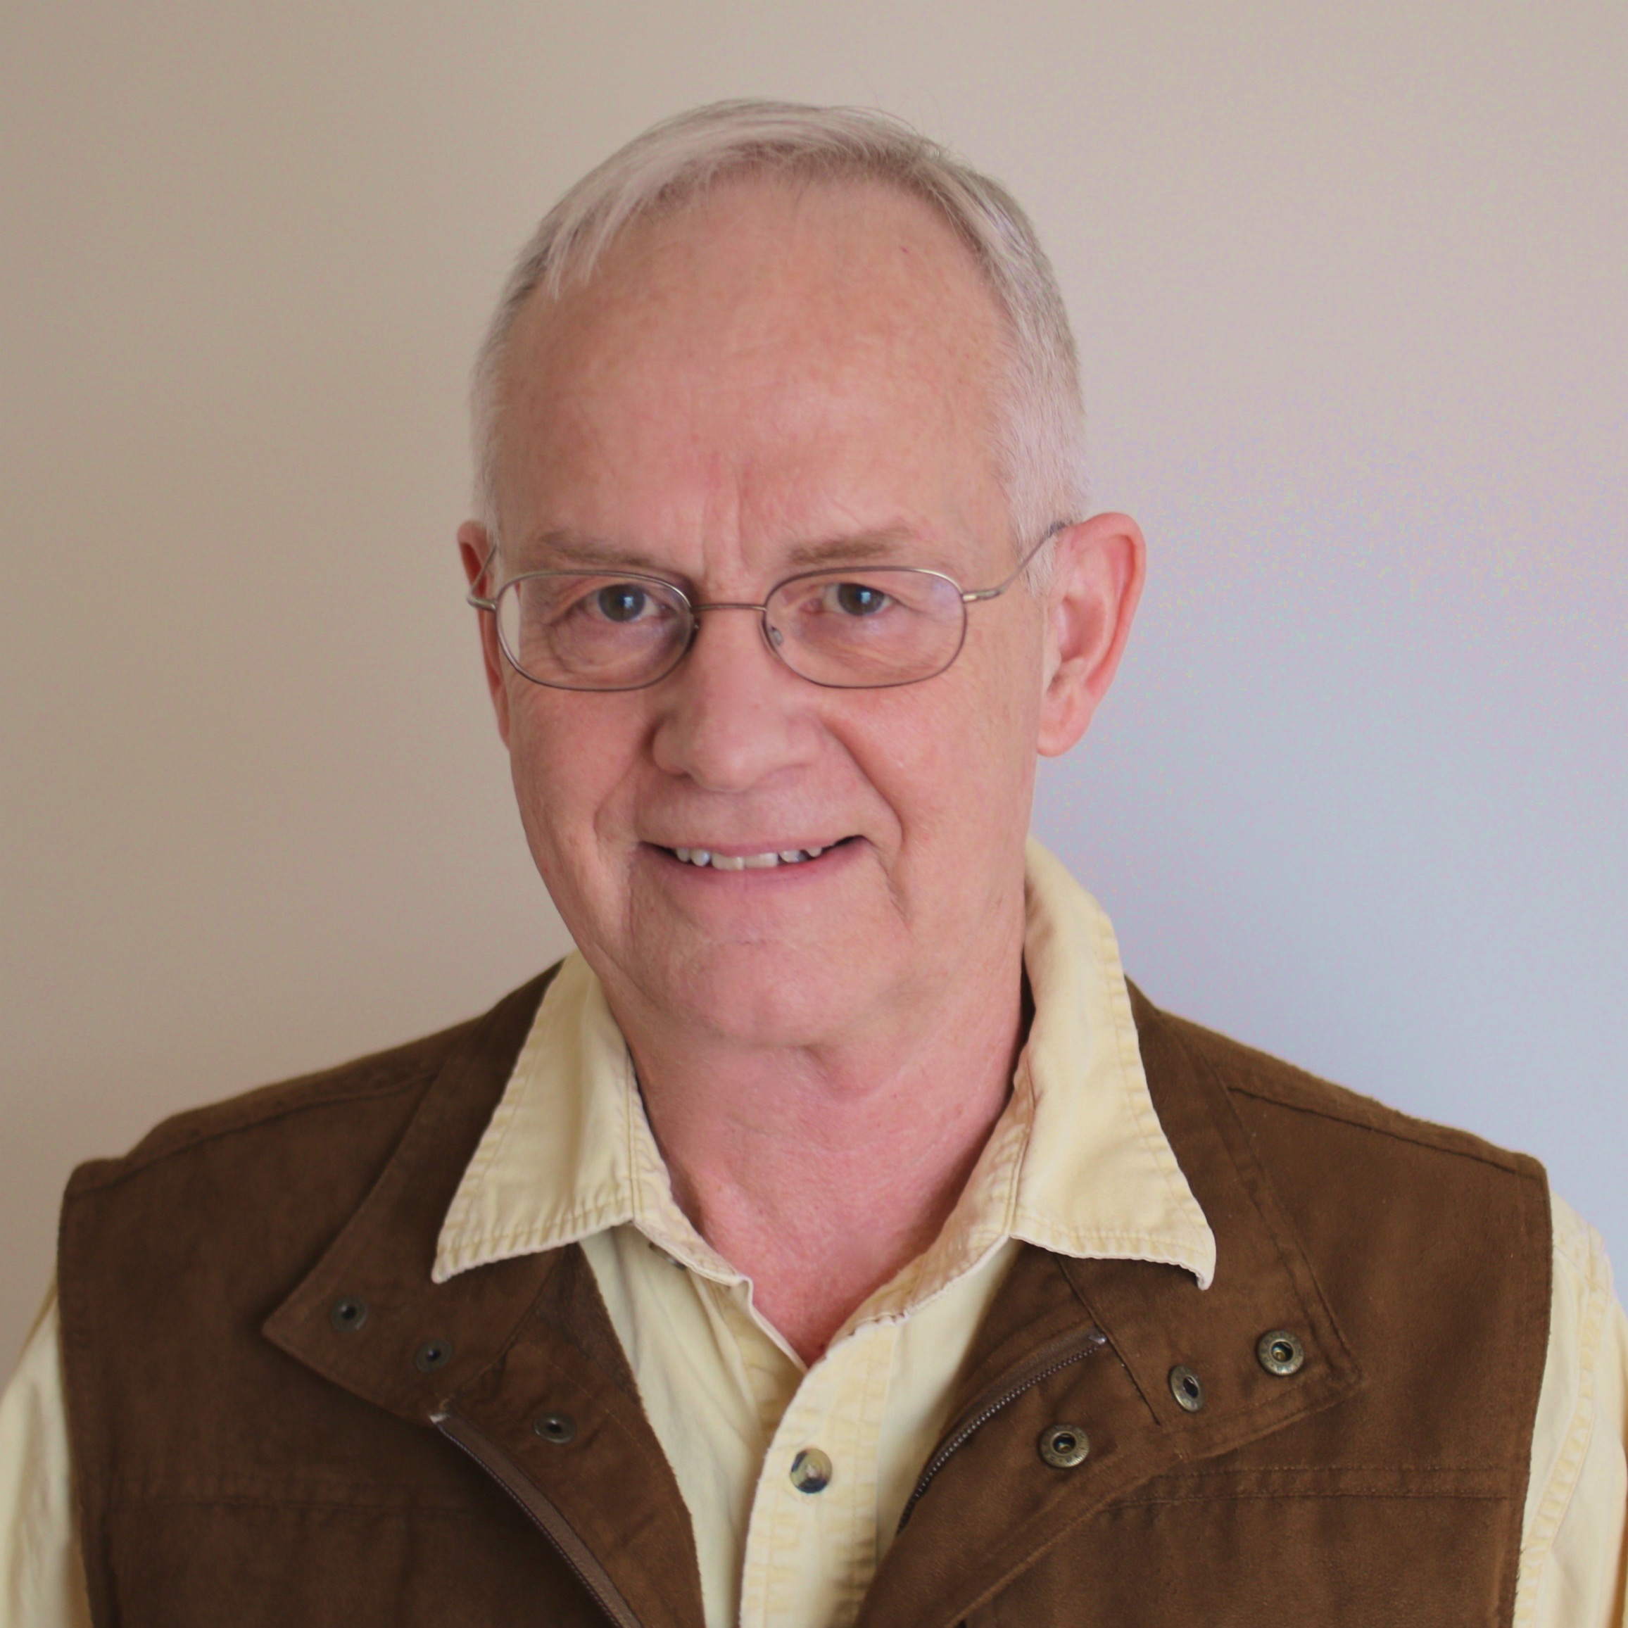
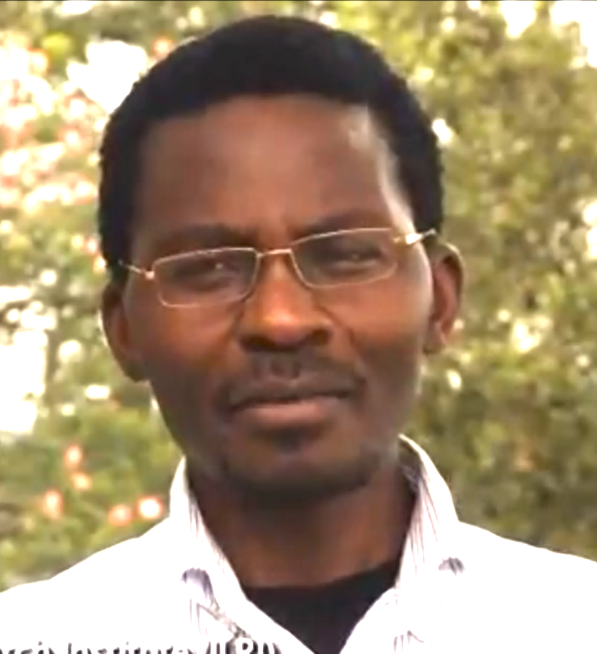
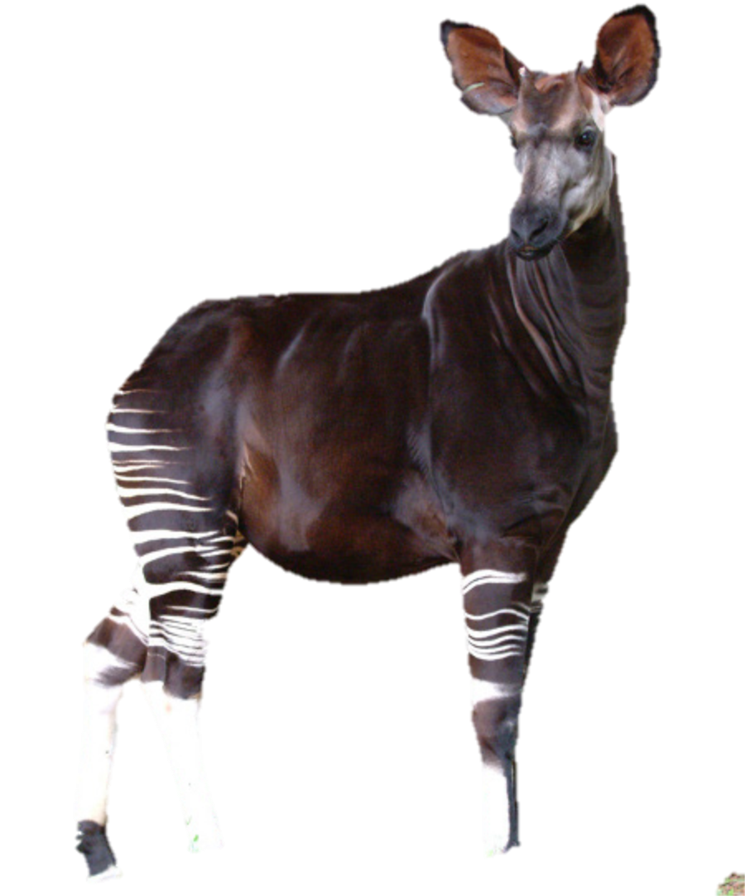
Giraffe Genome Project
Penn State University and Nelson Mandela African Institute for Science & Technology
teamed together to sequence and analyze the genomes
of the Giraffe and Okapi.
Project Leaders
Douglas Cavener, Penn State University -USA
Morris Agaba, Nelson Mandela African Institute
for Science and Technology - Tanzania

Slide 7
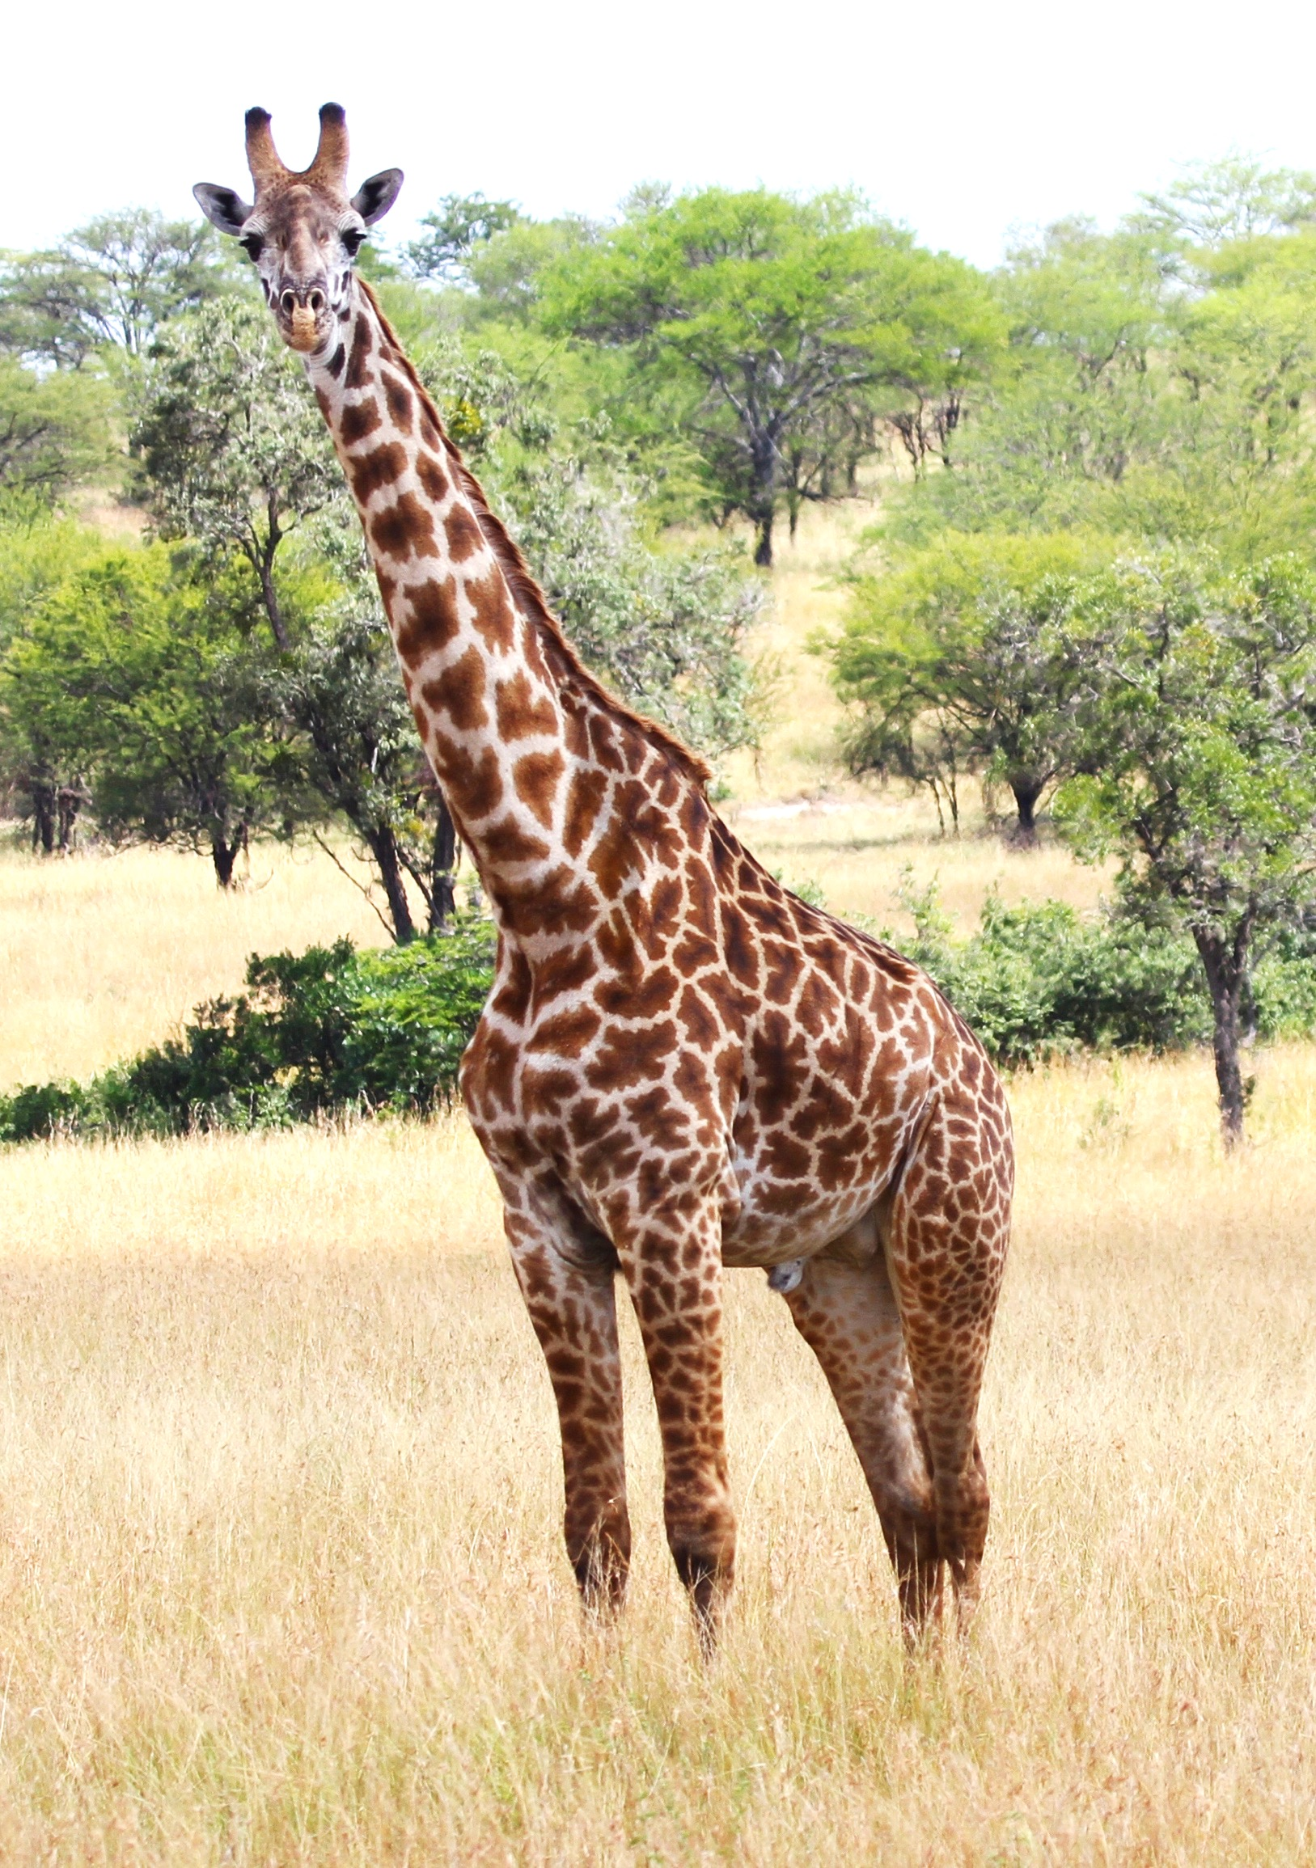
Goals of the Giraffe Genome Project
Discover the genetic basis of giraffe’s long neck and legs, and associated cardiovascular adaptations.
Identify unique adaptations related to nutrition and disease
Stimulate national pride in Tanzania of its iconic symbol & promote giraffe conservation.

Slide 8
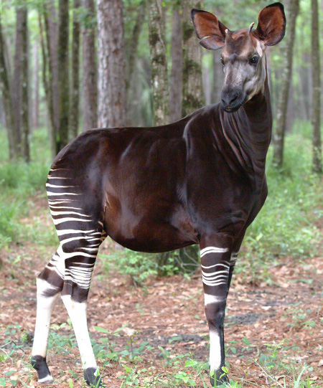
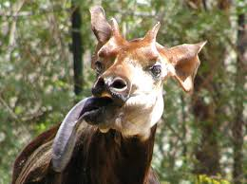
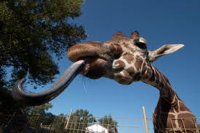
The giraffidae: Giraffa camelopardalis and Okapi johnstoni
Okapi lacks the extreme neck and leg elongation and cardiovascular adaptations.
Common features: skull morphology, ossicones (male only in okapi) dentation formula, lobed canines, long legs and splayed drinking, long tongues, and neck fighting.
Visual perception is much more pronounced in giraffe than okapi, and is correlated with giraffe's large eyes and preference for open savannahs, as opposed to Okapi’s preference for closed forests.
Giraffe 3-4 sacral vertebrae; okapi 5
Okapi have scent glands above each hoof; giraffe does not
Okapi licking grooming behavior is common; giraffe not

Slide 9
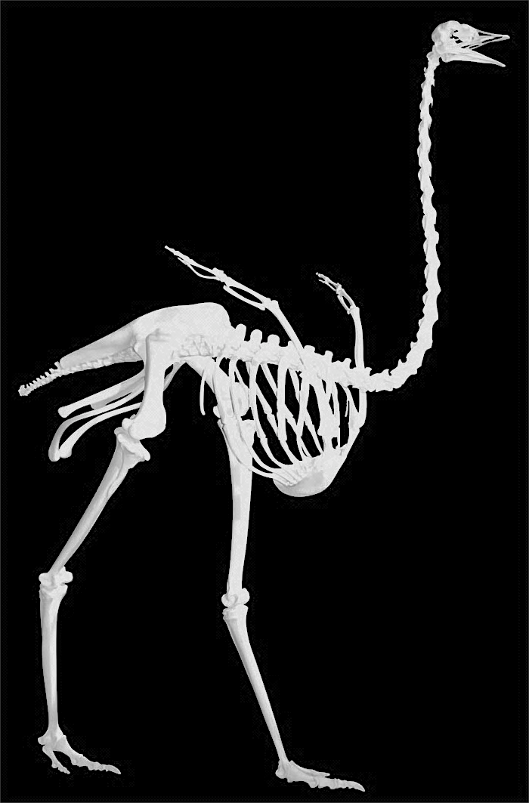
Question: How do you make a long neck?
Answer 1: Add more cervical vertebrae, as in birds and reptiles
West African
Ostrich
17 cervical vertebrae

Slide 10
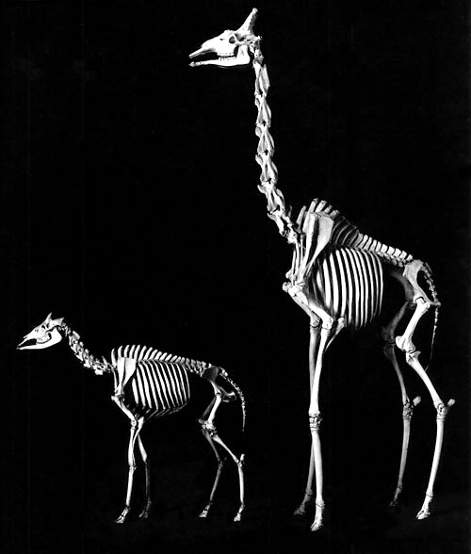
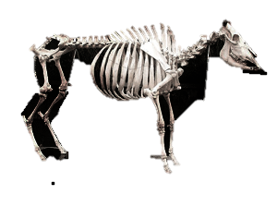
Answer 2: Mammals are restricted to 7 cervical vertebrae
Make longer cervical vertebrae
1
2
3
4
5
giraffe
6
7
1
2
3
4
5
6
7
3
1
4
2
7
5
6
okapi
cow

Slide 11
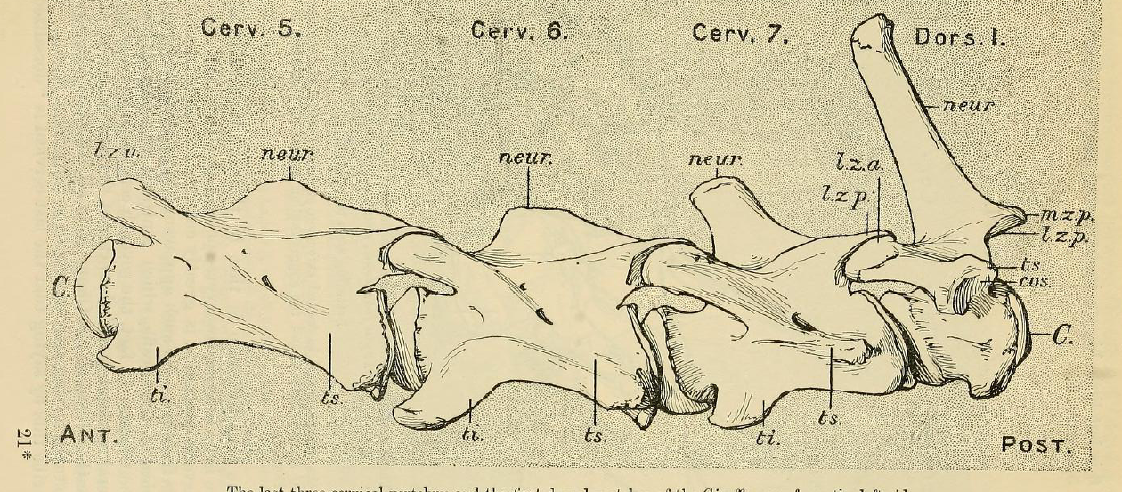
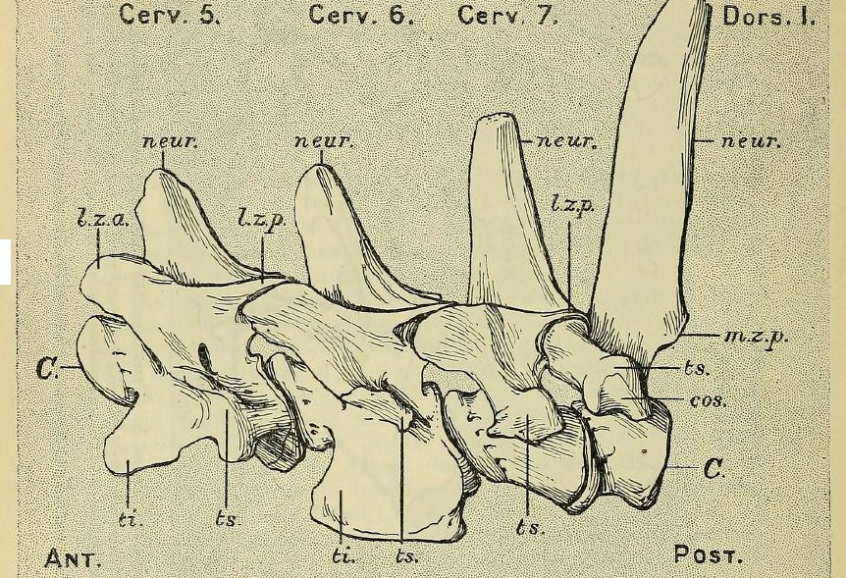
Special characteristics
of giraffe anatomy
Adults 16-19 ft tall; newborns 6ft tall
Long neck due to anterior-poster extension of the cervical vertebrae
which is accelerated postnatally
Elongation of the legs and particularly forelimbs (6 ft)
Shortening of the trunk
Long tongue up to 20” long (shared character with Okapi)
skin covered ossicones
7 cervical vertebrae
54% of axial skeleton length
Giraffe
shortened trunk
sloped back
Scapula longer
hips perpendicular
to back
Okapi
cervical vertebrae
35% of axial skeleton length
long trunk, flat back
Scapula shorter
canon bones
elongated

Slide 12
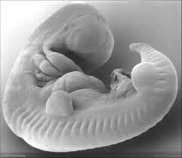
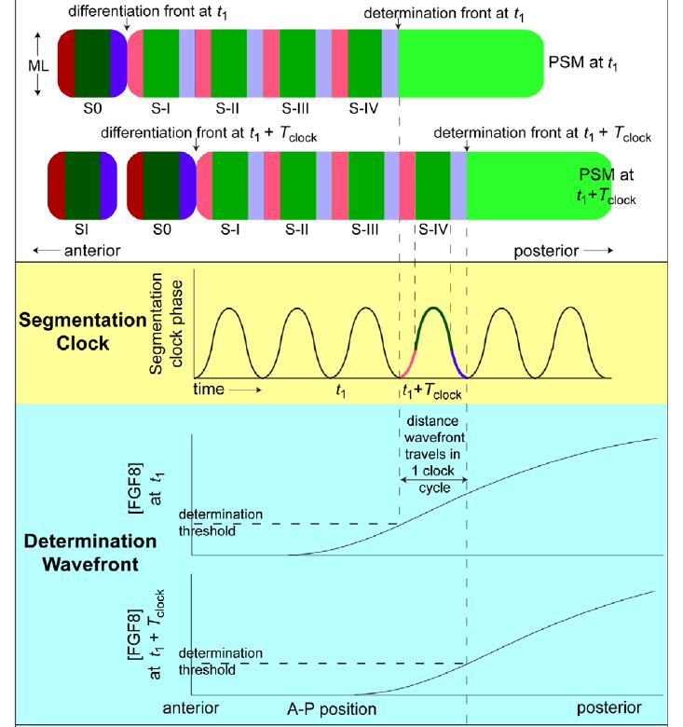
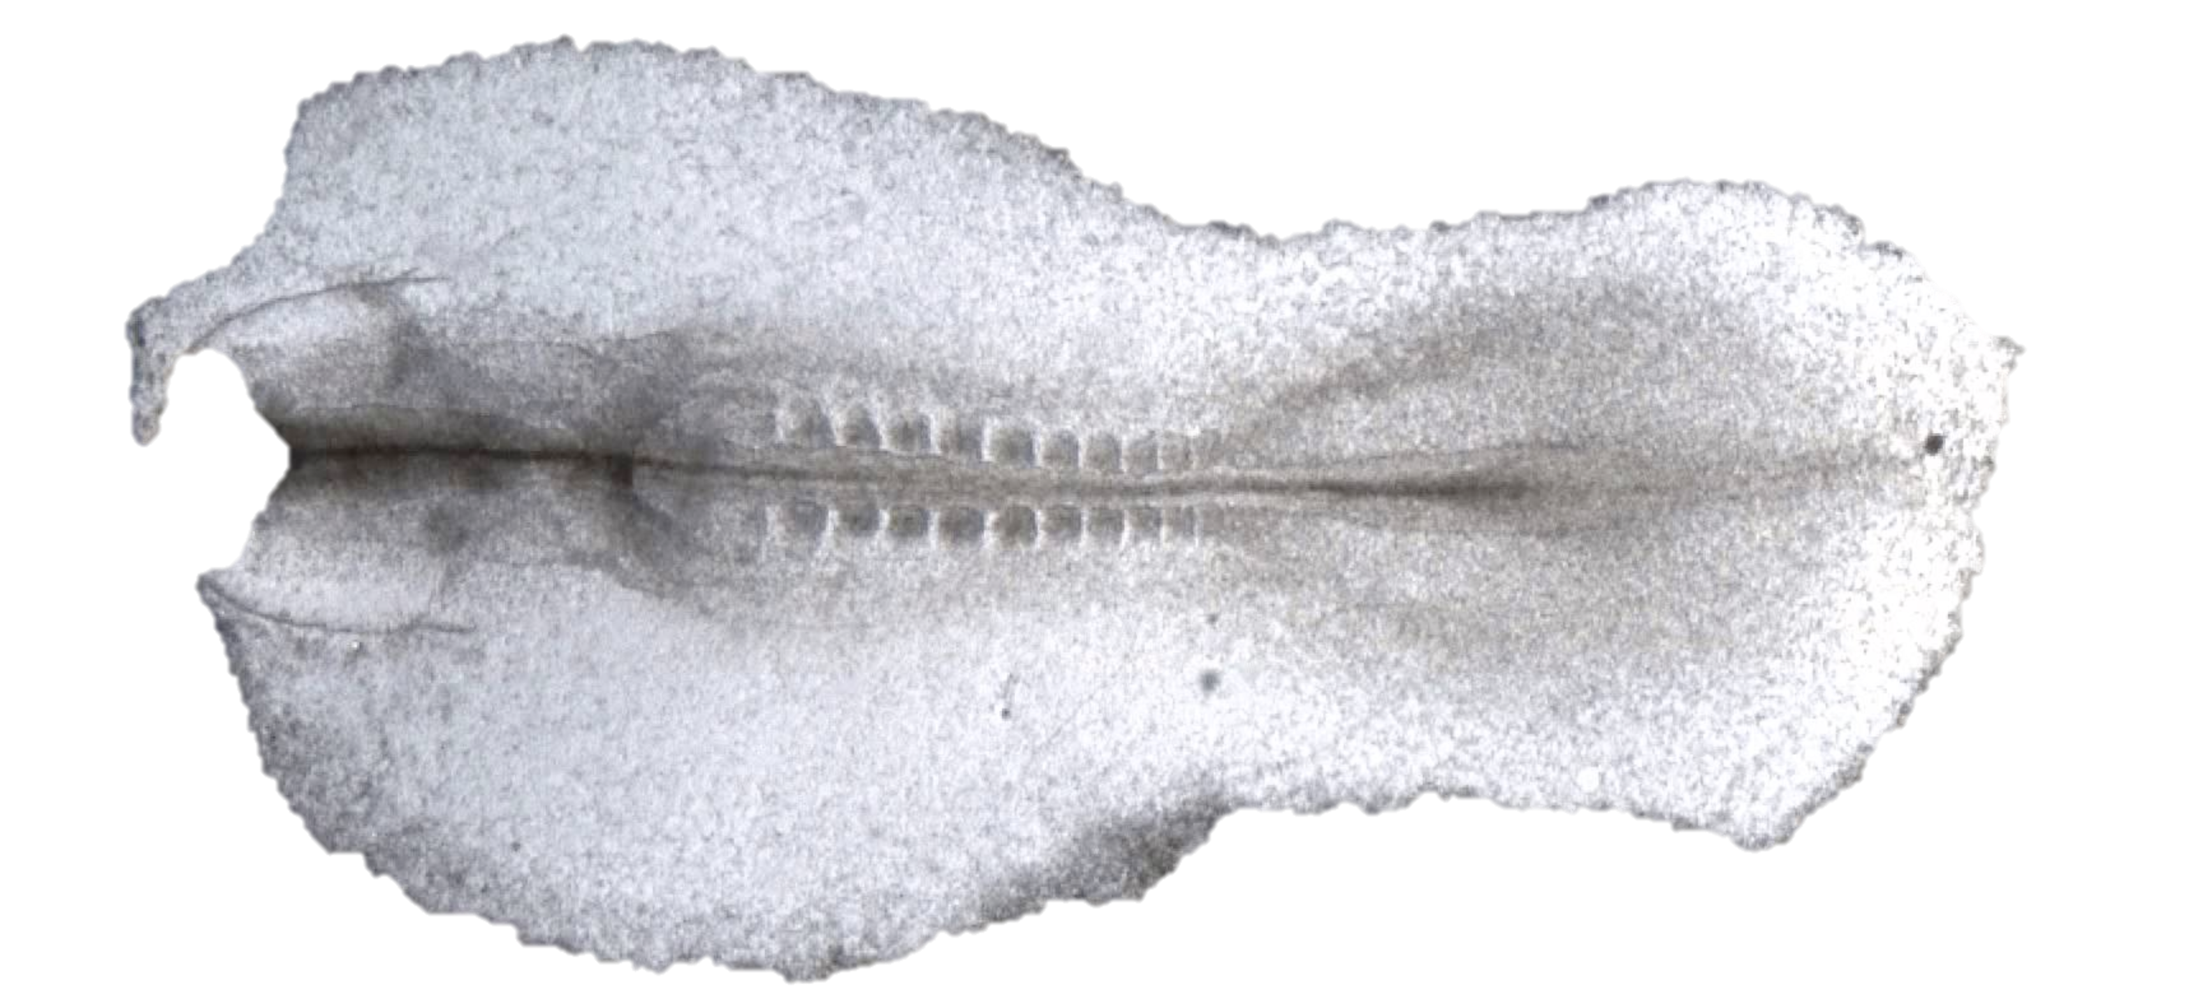
What is the developmental genetic basis for giraffe’s long neck?
Is it enlargement of somites in the anterior-posterior axis that give rise to long cervical vertebrae??
Somitogenesis is determined by an oscillator clock and a wave front of gene expression in vertebrates
somites
Notch & Wnt
Rostral
anterior
Caudal
posterior
FGF
http://youtu.be/y_-1i7kXnnY
http://youtu.be/9wrBROwoRSk
https://www.youtube.com/watch?v=CSjpXidXBPY
https://www.youtube.com/watch?v=T-fa1gYfwJk

Slide 13
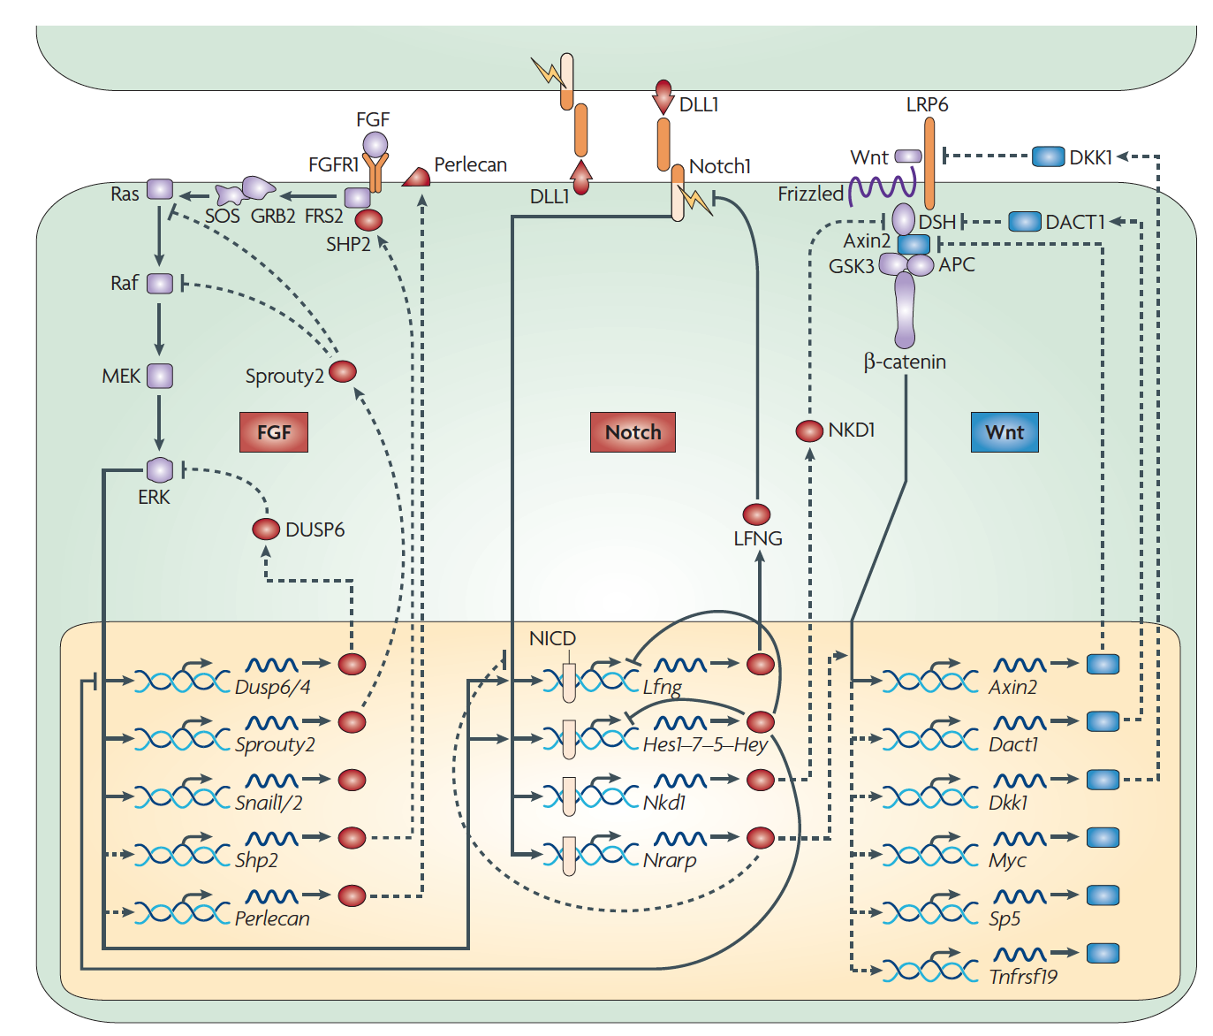
Somitogenesis – determining size and number of somites in vertebrates through
the FGF, Notch, and Wnt signaling pathways
JAG1
JAG1
FGF
Notch
WNT
Chemical inhibition of FGF signaling in chick embryo has been shown to increase somite length
Dequéant ML, Pourquié O. Segmental patterning of the vertebrate embryonic axis. Nat Rev Genet. 2008 May;9(5):370-82

Slide 14
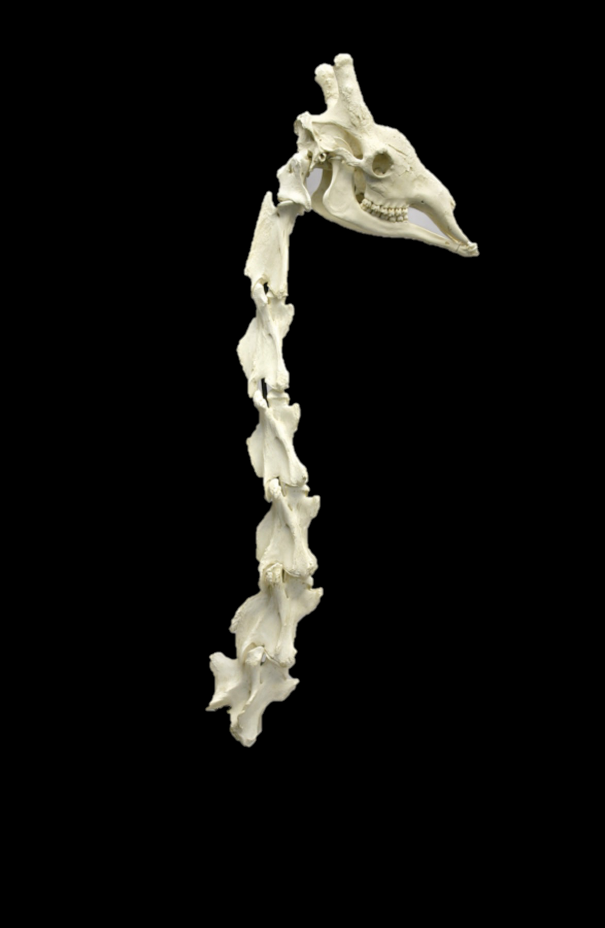
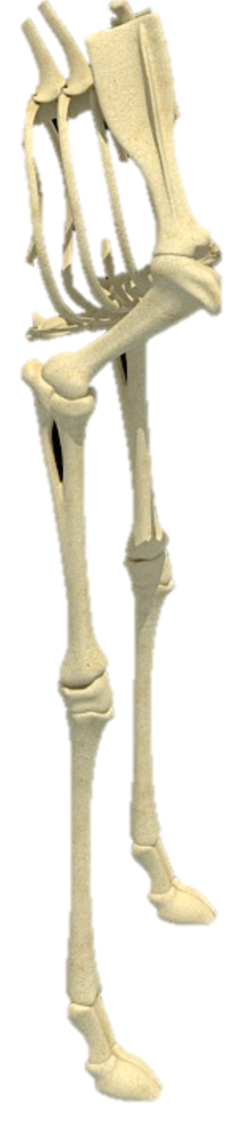
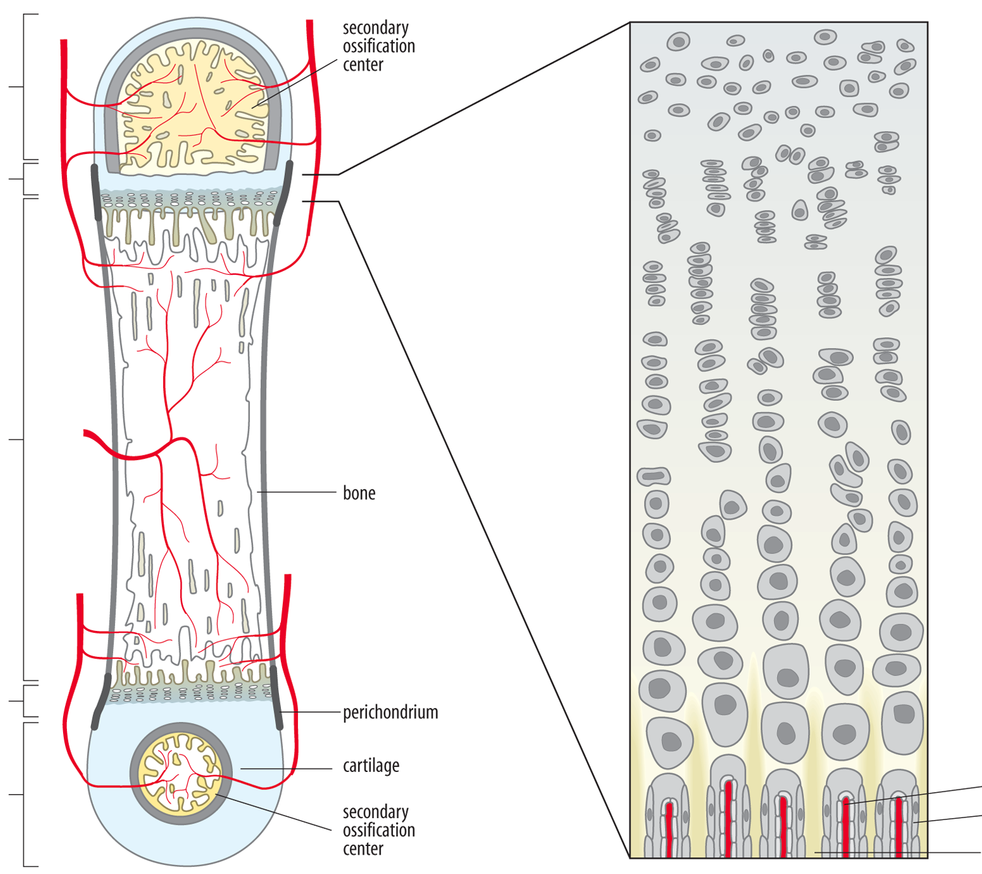
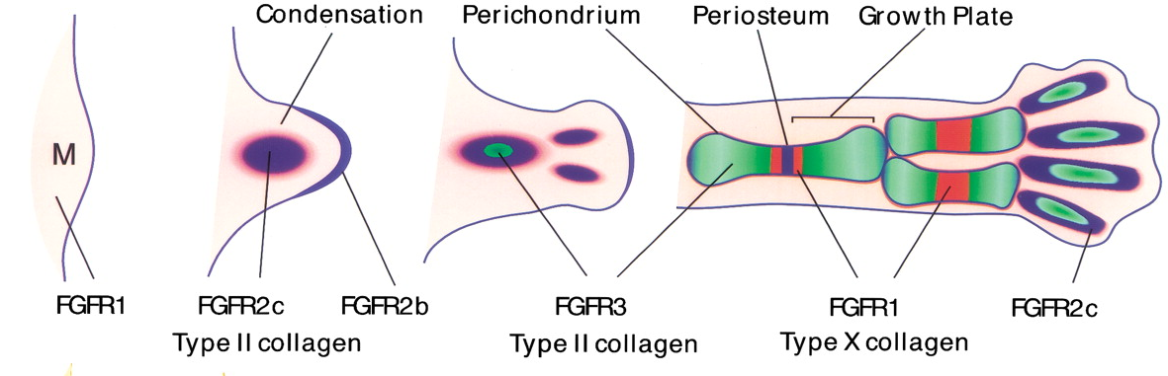
Following early somite formation….
Elongation of the rostral-caudal axis of cervical vertebrae and leg bones is accomplished by accelerating and extending chondrogenesis at the growth plates and is also regulated by the FGF pathway
Germinal zone
Proliferative zone
Maturation
Hypertrophic
Invading capillaries
Osteoblasts
Bone
Epiphysis
Growth plate
Diaphysis
Growth plate
Epiphysis

Slide 15
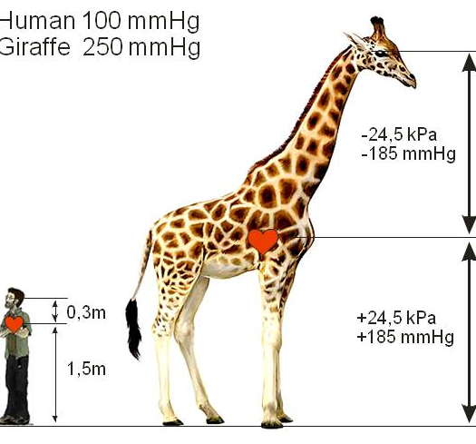
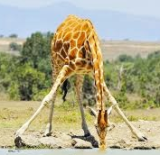
Giraffe - a turbocharged cardiovascular system to supply its brain with oxygenated blood
Blood pressure:
Human 100 mmHg
Giraffe 250 mmHg
-185 mmHg 2.5 meters
+185 mmHg 2.5 meters
-22 mmHg 0.3 meters
+110 mmHg 1.5 meters

Slide 16
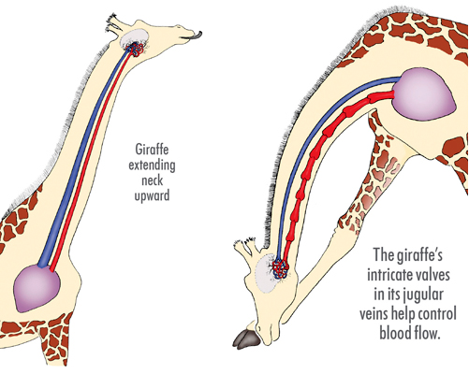
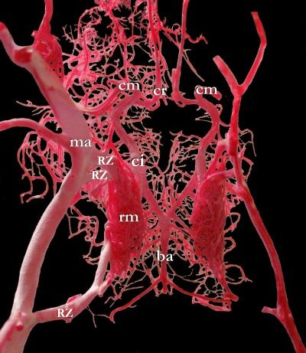
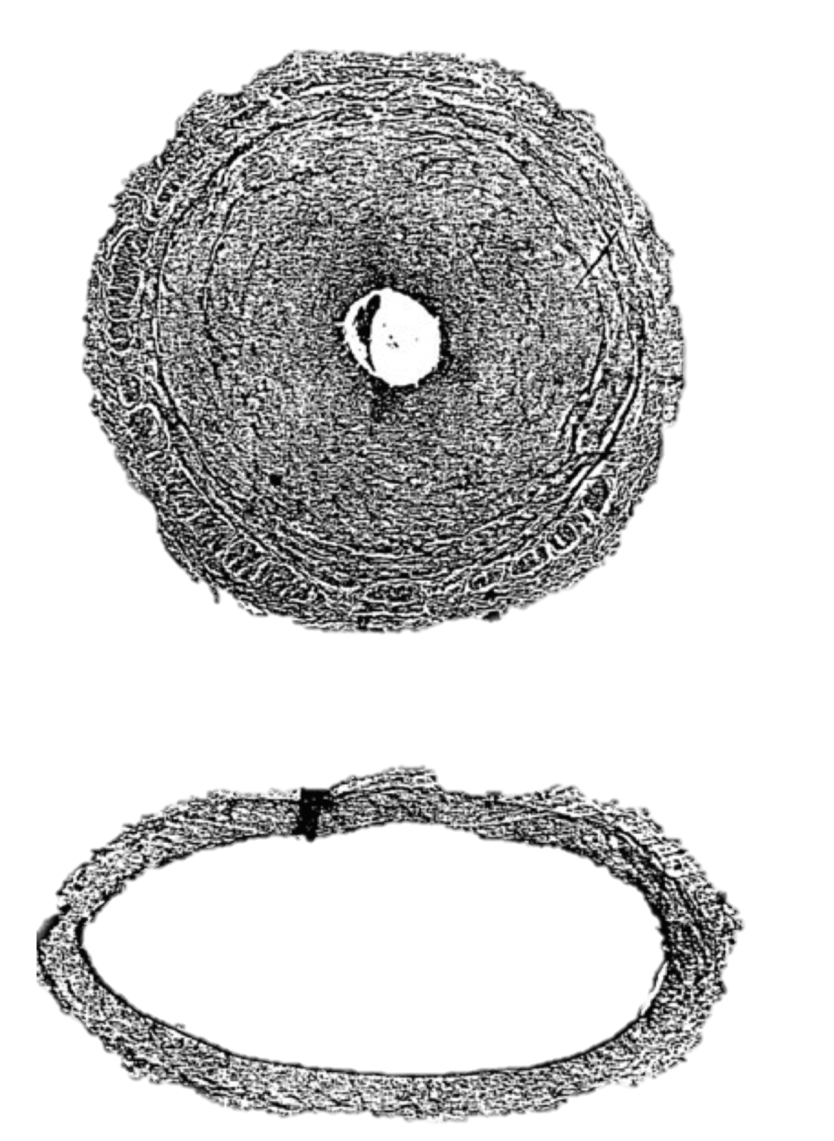
Adaptations of the cardiovascular system to handle extreme hydrostatic pressure variation associated with movement
Left ventricular wall hypertrophy (ca. 2X of expected for mammals) to get the pressure up
Thickened blood vessel walls (tunica media) in lower extremities
To counteract the potential rapid rush of blood to the brain when giraffes lower their head to drink:
- rete mirable impedes rapid arterial blood flow to the brain
- jugular vein valves prevent backflow of blood from the heart and inferior vena cava to the head.
Posterior tibial artery
Carotid artery

Slide 17

Q: What determines giraffe’s long neck and legs?
A: DNA sequence of the genes!
Our studies suggest that small differences in less than 30 developmental regulatory genes are responsible for giraffe’s long legs and neck.
Q: How did we find the responsible DNA sequences and genes?
A: Compared giraffe with other animals that don’t have a long neck and legs and see what the is difference in DNA sequence.

Slide 18
Giraffe and Okapi genome sequence and analysis
Whole genome sequencing performed on Illumnia HiSeq 2500 at Penn State University.
Current coverage is ca. 30X for one giraffe from Maasai Mara (MA1) and one okapi from White Oak Conservation Center, and 30X for one additional giraffe from the Nashville Zoo (NZOO). Confirmation of specific genes in Reticulated and Rothschild giraffe.
SNP calls and gene predictions were generated using cow and dog transcript models
- Webb Miller’s group (Penn State)
De novo assembly Giraffe MA1 and Okapi
- Paul Medvedev & Rayan Chikhi (Penn State)
Giraffe assembly = 2.9Gb Scaffold N50 = 339Kb Contig N50 = 47kb
Okapi assembly = 3.3Gb Scaffold N50 = 105Kb Contig N50 = 34Kb

Slide 19
Giraffe and Okapi genome analysis
Analysis of candidate developmental genes controlling pattern formation, differentiation, and growth of the axial and appendicular skeleton e.g. Wnt, FGF, Notch, Hox pathways
Genome-wide analysis of amino acid substitutions and dN/dS - Galaxy platform used to screen for genes where dN/dS was substantially greater for giraffe- cow versus okapi-cow, followed by GO/function and KEGG/pathway analyses on the resultant sets
Relative protein sequence divergence as assessed by phylogenetic tree analysis
Identification and statistical analysis of unique amino acid substitution in giraffe and okapi at otherwise invariant sites in mammals/vertebrates
Branch-site test for positive selection (Zhang, Yang, and Nielsen)
PolyPhen2 – prediction of impact of an amino acid substitution on protein, based on amino acid chemistry, phylogenetic comparisons, and impact on the protein structure
Multiple Signs of Adaptation (MSA) - Concordance of dN/dS, unique substitutions, positive selection, Polyphen, and relative amino acid sequence divergence was determined to identify genes most likely to be functionally diverged in giraffe – yielding 71 genes

Slide 20
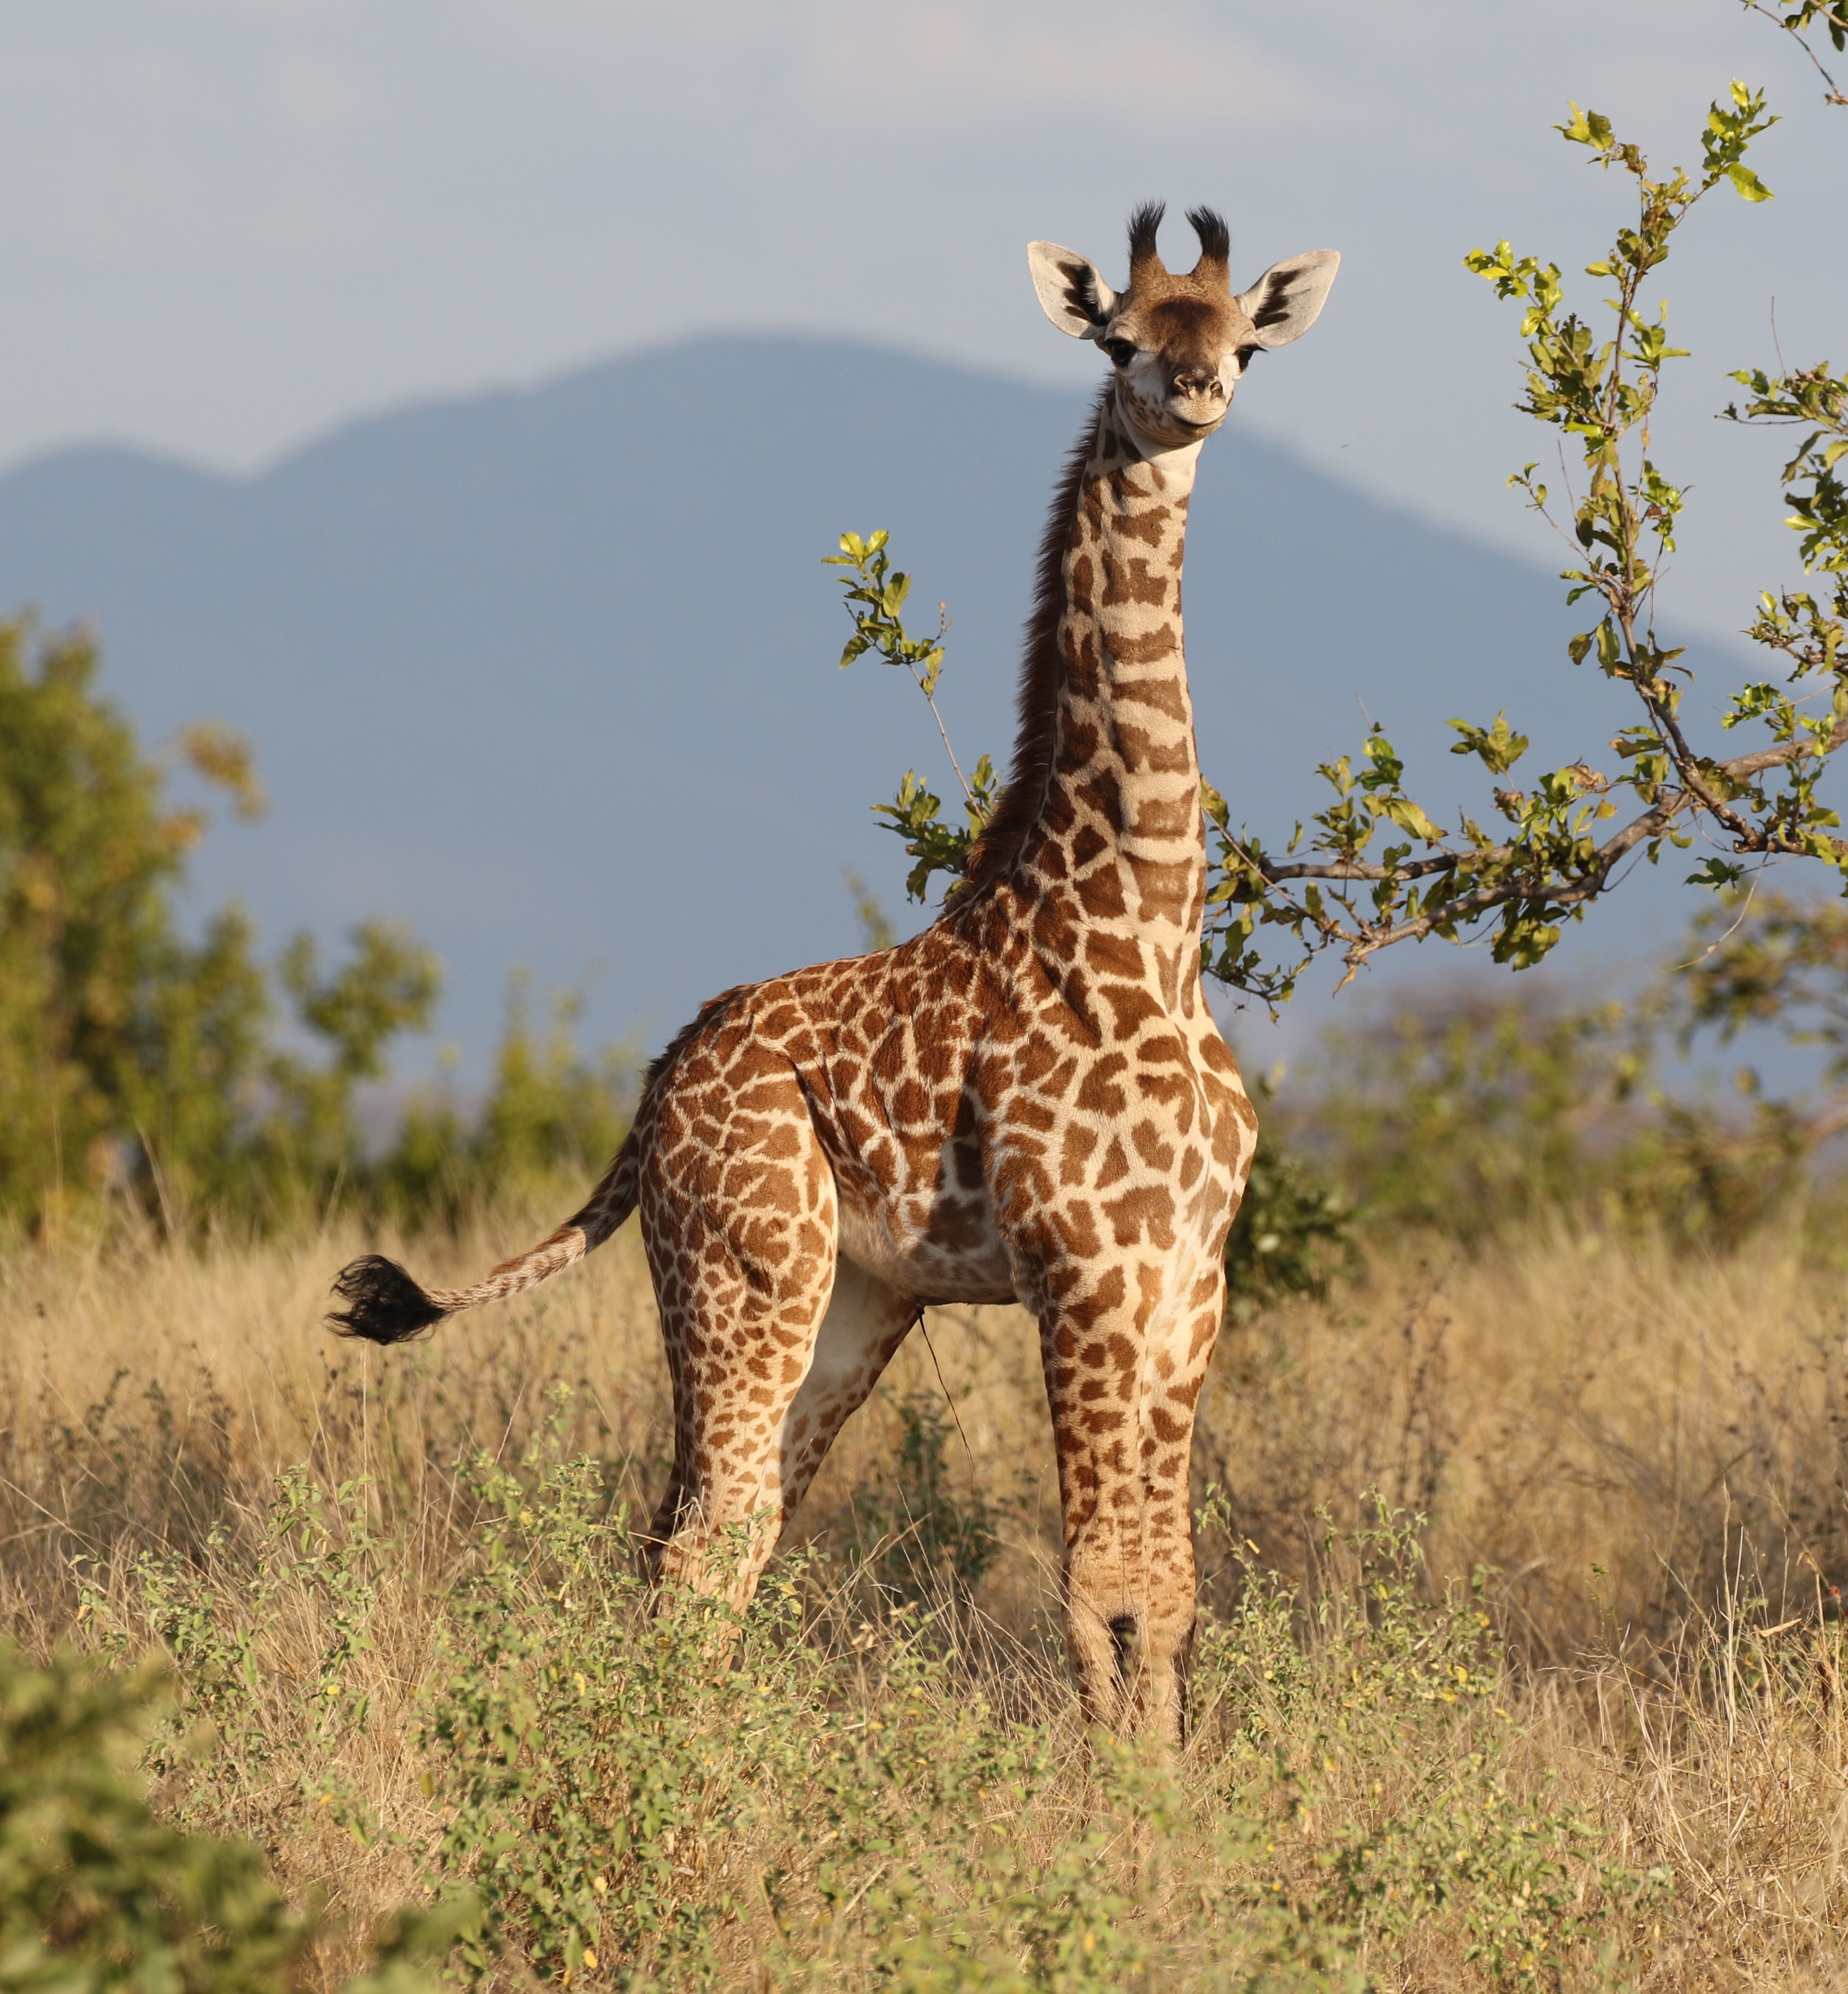
We could compare giraffes and human ….
Giraffe and humans are mammals
3 billion base pairs of DNA sequence and ca. 20,000 genes.
95% of these genes are shared among all mammals.
Diverged from a common ancestor ca. 90 mya
20,000 genes X 480 amino acids per gene = 9.6M total amino acids
Human vs giraffe 4.1% different = 280,500 amino acid differences
Cattle and okapi provide a closer comparison
Cattle and giraffe diverged from a common ancestor 28mya
Okapi and giraffe diverged from a common ancestor 11.5mya
Cattle vs giraffe 1.4% different = 91,800 amino acid differences
Okapi vs giraffe 0.6% different = 37,400 amino acid differences

Slide 21
37,400 amino acid differences between giraffe and okapi
-> But most of these amino acid differences will not effect form and function.
How did we discover which ones are likely to be responsible for giraffe unique features??
Identify sequence differences that are unique to giraffe compared to other mammals (30-50 species)
Identify sequence differences that are predicted to effect function based on chemistry and known importance of a sequence
Identify sequence differences that show statistical evidence for positive selection.
Identify genes that contain multiple amino acid differences and high divergence from other mammals.
Combining these factors together identified 70 genes with Multiple Signs of Adaptation (MSA).

Slide 22
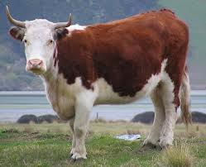
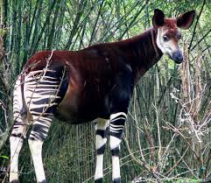
Cow was used as the key initial outgroup for comparing giraffe and okapi genomes
cow
giraffe
okapi
11.5 mya
28 mya
ancestral pecoran
Horned, even-toed ungulates
dN dS proteins identical
giraffe-okapi 0.0055 0.02548 19.40%
giraffe-cattle 0.1350 0.06127 9.24%
okapi-cattle 0.0135 0.06136 9.59%

Slide 23
GO biological process - protein that have diverged more between
Giraffe vs. Cow than Okapi vs. Cow - dN/dS screens
P-value
0.000031 mitochondrial inner membrane
0.000035 mitochondrial matrix
0.00039 negative regulation of cell migration
0.00057 positive regulation of cell proliferation*
0.00064 ossification
0.0012 glutamate metabolic process
0.0035 calcium-dependent cell-cell adhesion
0.0035 negative regulation of axon extension
0.0053 Wnt receptor signaling pathway
0.0058 organic anion transport
0.0063 visual perception
0.0064 bone development
0.0075 angiogenesis
*Note: Okapi enriched for negative regulation of cell proliferation
cow
giraffe
okapi
11.5 mya
28 mya

Slide 24
Majority of MSA genes regulate skeletal, cardiovascular, and neural functions
Skeletal
Cardiovascular
AXIN2
NOTO
TGFB1
NFXL1
DLL3
E2F4
HOXB13 CDX4
JAG1 FGFRL1 ITGA10
ECM1 SEMA3E ETS2
IFT74
ENG
HoxB3
Notch4 CREBBP
SEMA3A
FOLR1
MYC
FOS JARID2
E2F5 ALDH16A1 CYP27B1
SLIT2 PRPH2
Neural

Slide 25
Giraffe genes exhibiting multiple signs of adaptations
Network analysis of GO Biological Processes
Metabolism and Mitochondrial
Development
Cell Proliferation
Blood Pressure and Circulation
Immunity
DNA Repair
Nervous System
Centrosome
Chelsea Hudson & Doug Cavener

Slide 26
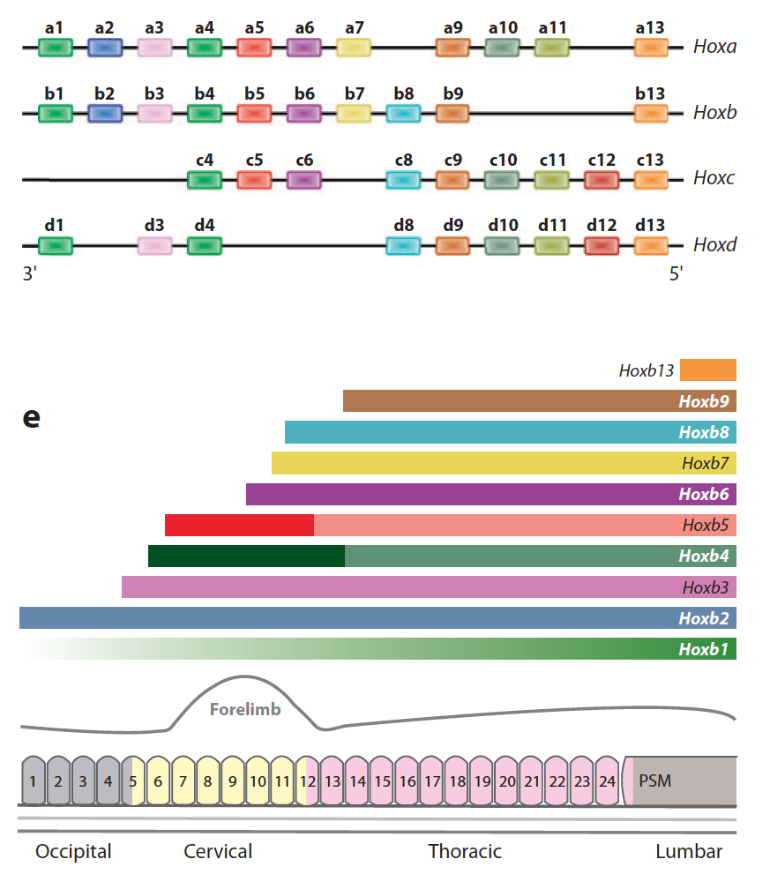
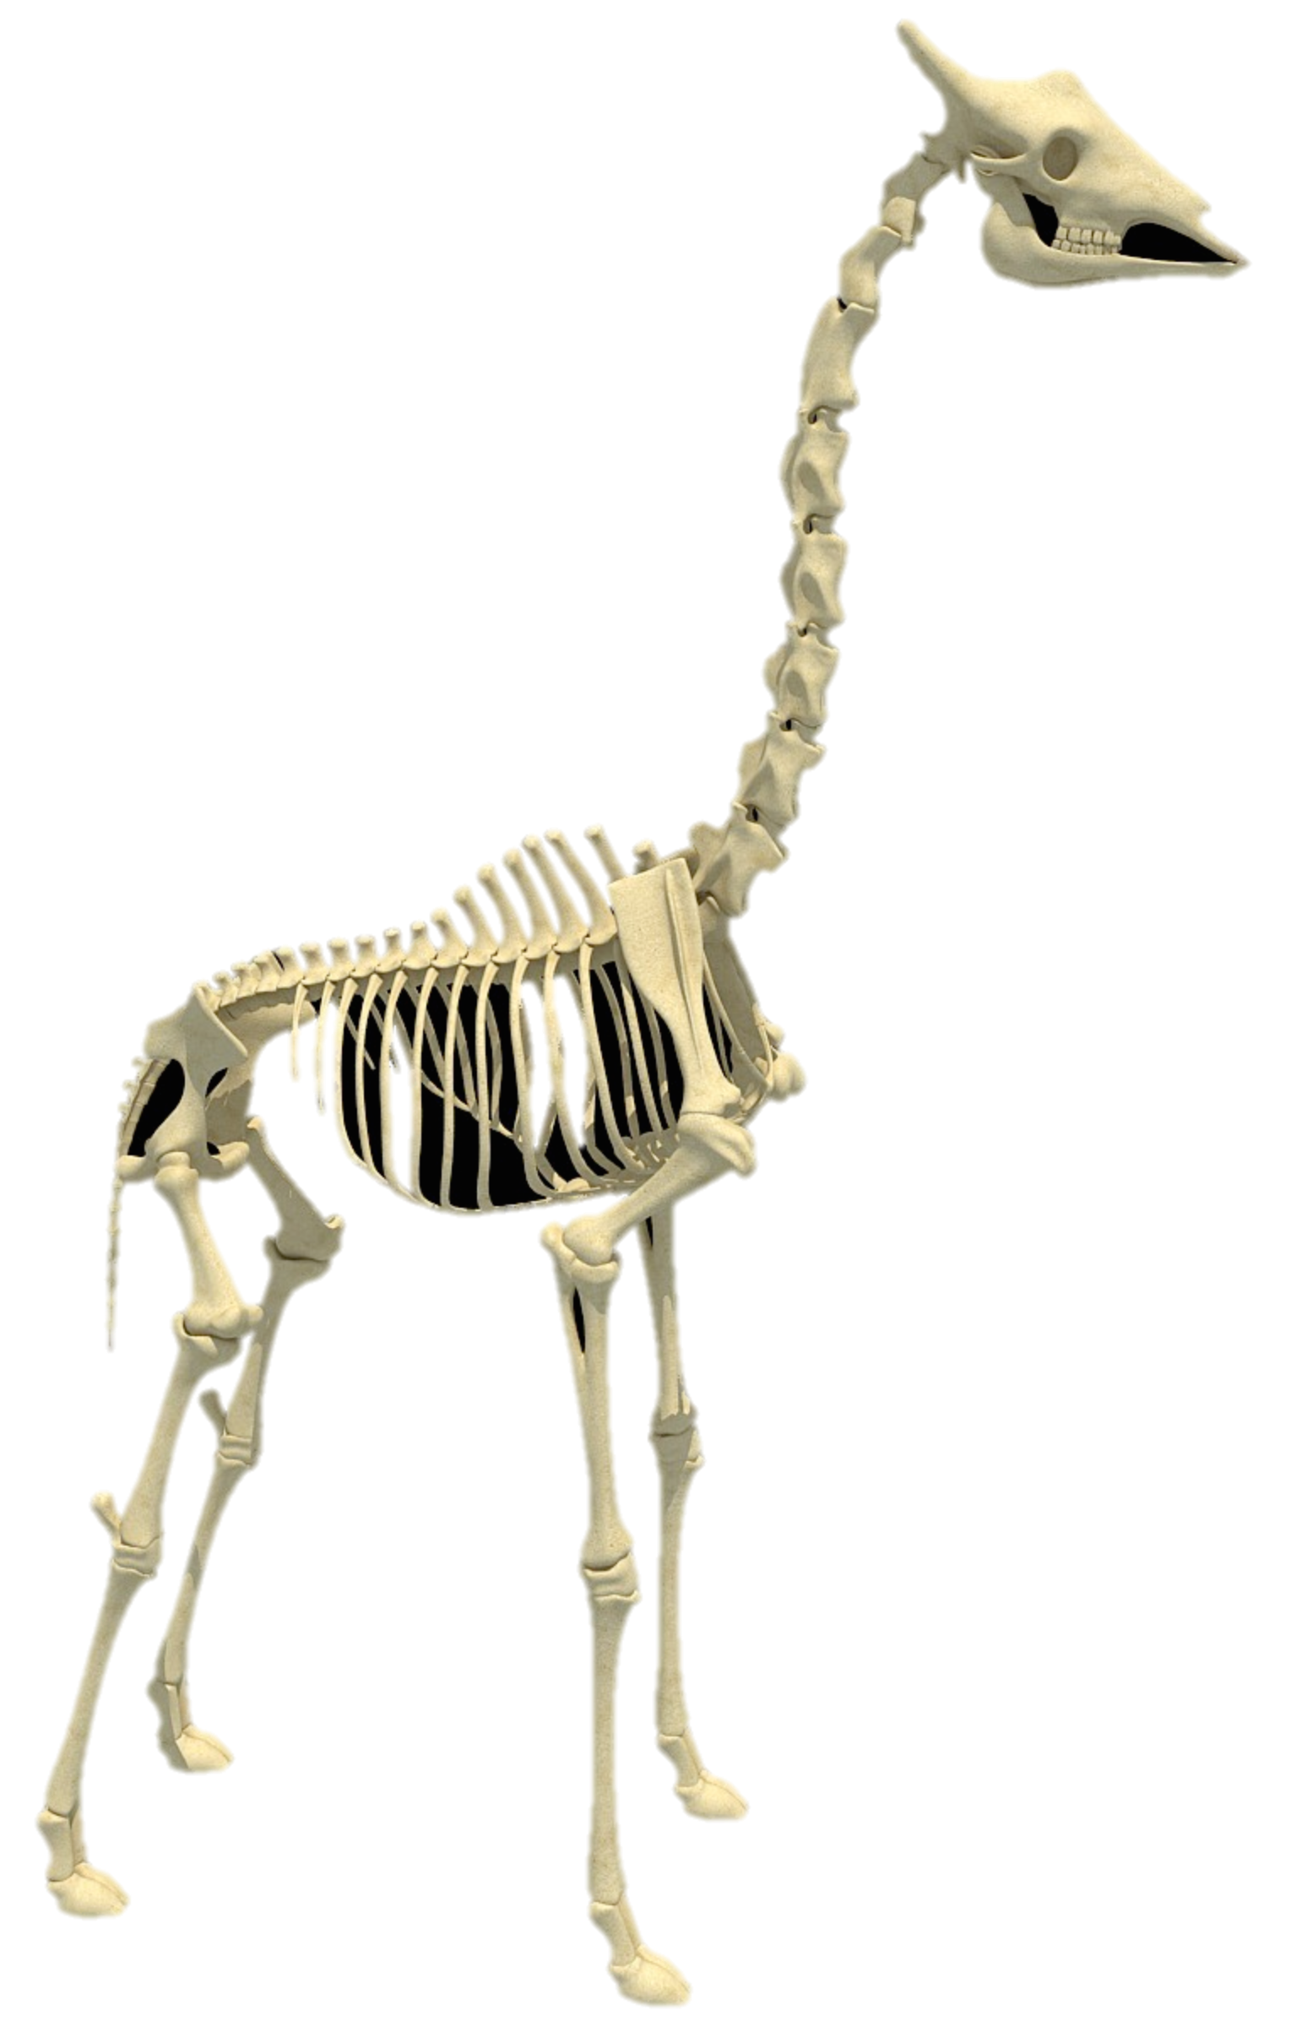
Unique amino acid substitutions in 4 homeobox genes of giraffe may specify the region
of the axial and appendicular skeleton to be elongated
HoxB3
Forelimb
Cervical

Slide 27
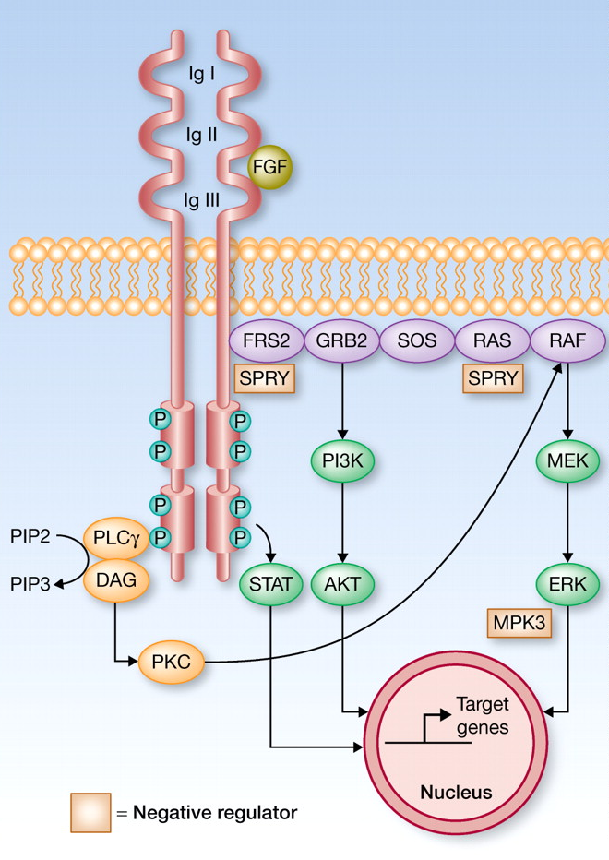
FGFRL1 – a decoy FGF receptor lacking TK domain is highly diverged in giraffe
in the FGF binding domain
FGFR
FGFRL1
dN/dS giraffe-okapi = 2.9
Giraffe - highest mean dN/dS among mammals
- significantly more unique substitutions
Ig-I
C
C
Heparin binding
C
C
Ig-II
C
C
cow KPVLTGTHPVNTTVDFGGTTSFQCKVRSDVKPVIQWLKRVEYGAEGRY
Giraffe* .......A.......GS.....L..R.....R.........D......
Okapi ................................................
Unique in mammals + ++ +
Polphen hit ++ + + +
* Confirmed in Masai, Recticulated, and Rothschild subspecies
FGF binding
C
C
Ig-III
C
C
C
C
Zinc
binding
Tyrosine kinase 1
Tyrosine kinase 2
Functions of FGF signaling:
- somitogenesis wavefront gradient
- angiogenesis
- regulation of chondrogenesis at growth plate
- cardiogenesis
Mutations in FGFRL1
Humans: Wolf-Hirschhorn syndrome- achondroplasia
Mice : hypoplasia in all skeletal elements, shortened axial and appendicular skeletons, malformation of the vertebrae, delayed mineralization in cervical vertebrae, heart defects

Slide 28
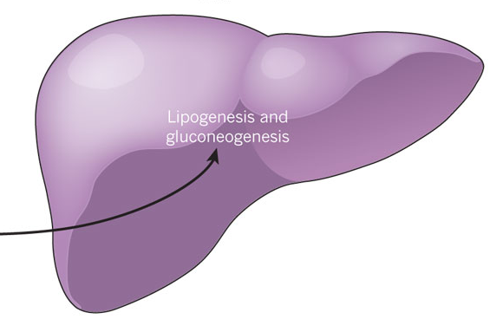
Accelerated evolution of 5 butyrate metabolism genes in giraffe
Rumen
Rumen epithelial and peripheral tissue
mitochondria
Venous
blood
MCT1
Rumen
butyrate butyrate
butyrate
CoA
β-hydroxy
butyrate
β-hydroxy
butyrate
Esophagus
ACSM3
ACADS
Omasum
hydroxy butanoyl
CoA
β-hydroxy
butyrate
Abomasum
Microbial
fermentation
Reticulum
Peripheral tissue
mitochondria
acetyl-CoA
VFA
NADH
TCA cycle
NADH dehydrogenase
Ubiquinone Complex I
Succinate dehydrogenase
Complex II
ATP
NDUFB2
SDHB
Gluconeogenesis
Lipogenesis
Liver
Mutations in SDHB, ACSM, ACADS and MCT1 in humans cause cardiovascular phenotypes involving blood pressure

Slide 29
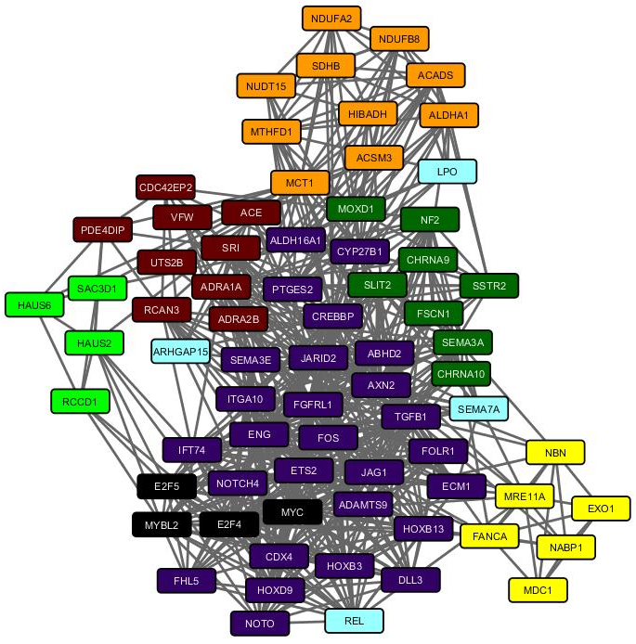
The “diminishing bread” hypothesis
Vit-A is found in leafy vegetables; Is involved very early in embryo development. Key enzymes involved absorption and conversion Vit-A to active form have substitutions that are unique to giraffe
Vitamin A
Folic Acid
Folic acid is found in leafy vegetables.
Is involved in embryo development. Genes involved in folic acid metabolism including a key folic acid receptor (FOLR1) have substitutions that are unique to giraffe
?
Genes that are known to play critical role in axial segmentation have evidence of accelerated evolution in giraffe
Axial
development

Slide 30
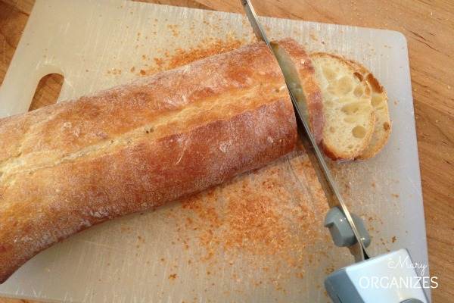
The “diminishing bread” hypothesis
You have a baguette to share among 12 guests, and each to get equal share of available bread.
So you prepare to cut 12 slices. As you get to the sixth, 2 new guests arrive.
Thereafter, a new guest arrives for every slice you cut.
A guest then gets a dinner portion proportional to bread received.
Neck
Chest &
fore legs
Lumbar
Sacrum &
hind legs

Slide 31
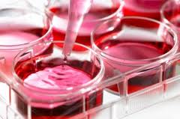
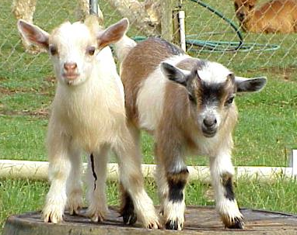
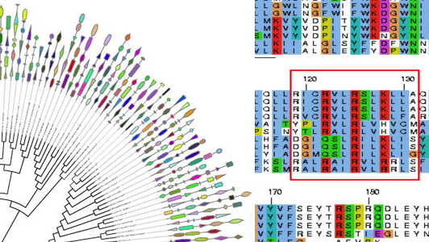
Future functional studies to test relevance of identified genetic differences
Determine if unique changes in giraffe genes result in quantitative differences in physiological/developmental processes
- heterologous cell culture
- substituted in animal models e.g. mouse and dwarf goat using CrispR-Cas9
mutagenesis
Develop novel strategies to treat human and livestock diseases based on knowledge of how giraffe has solved extreme physiological challenges such as:
high blood pressure
cardiovascular output
Nutritional utilization of toxic plants.

Slide 32

Penn State University
Douglas Cavener
Barbara McGrath
Chelsea Hudson
Brendan Wood
Lan Wu-Cavener
Webb Miller
Aakrosh Ratan
Robert Harris
Oscar Bedoya Reina
Rico Burhans
Paul Medvedev
Rayan Chikhi
Craig Praul
Nelson Mandela AIST
Morris Agaba
Edson Ishengoma
Biological samples
Heather Robertson,
Nashville Zoo
Linda Penfold,
White Oak Conservation
Oliver Ryder,
San Diego Zoo

Slide 33
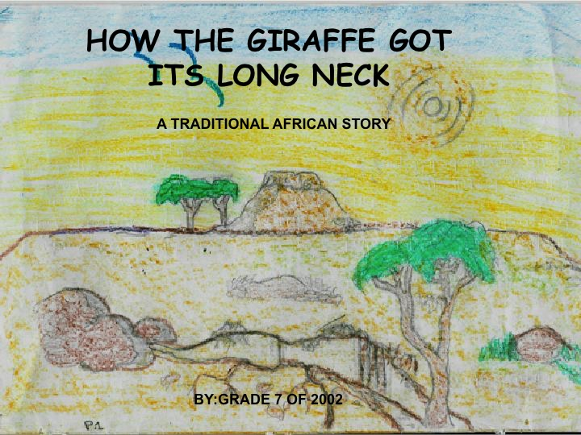
2002 Class 7 of the Good Shepherd Primary School, Eastern Cape, South Africa

Slide 34
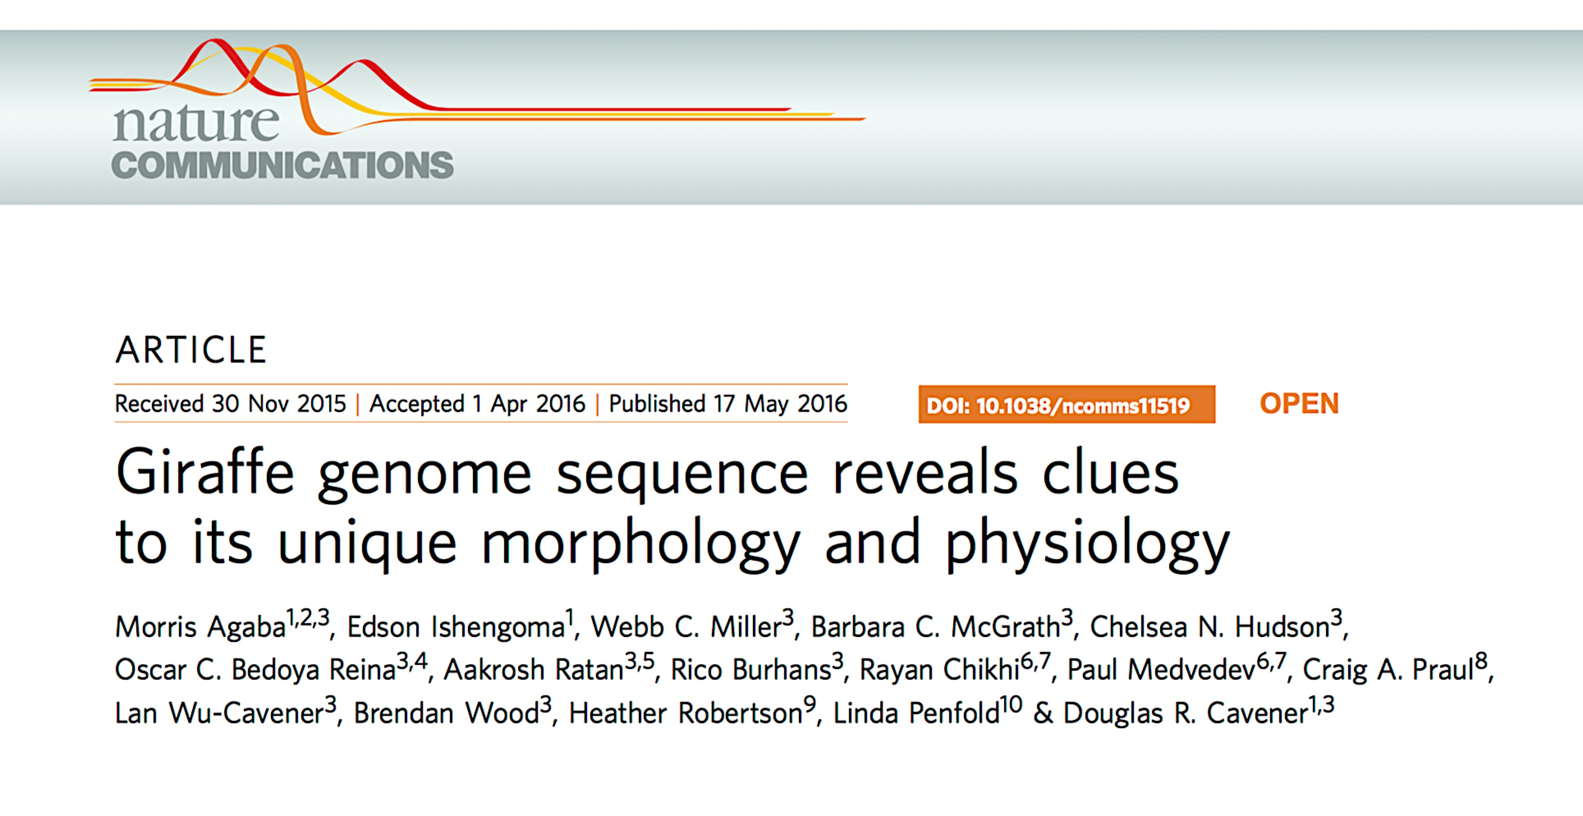

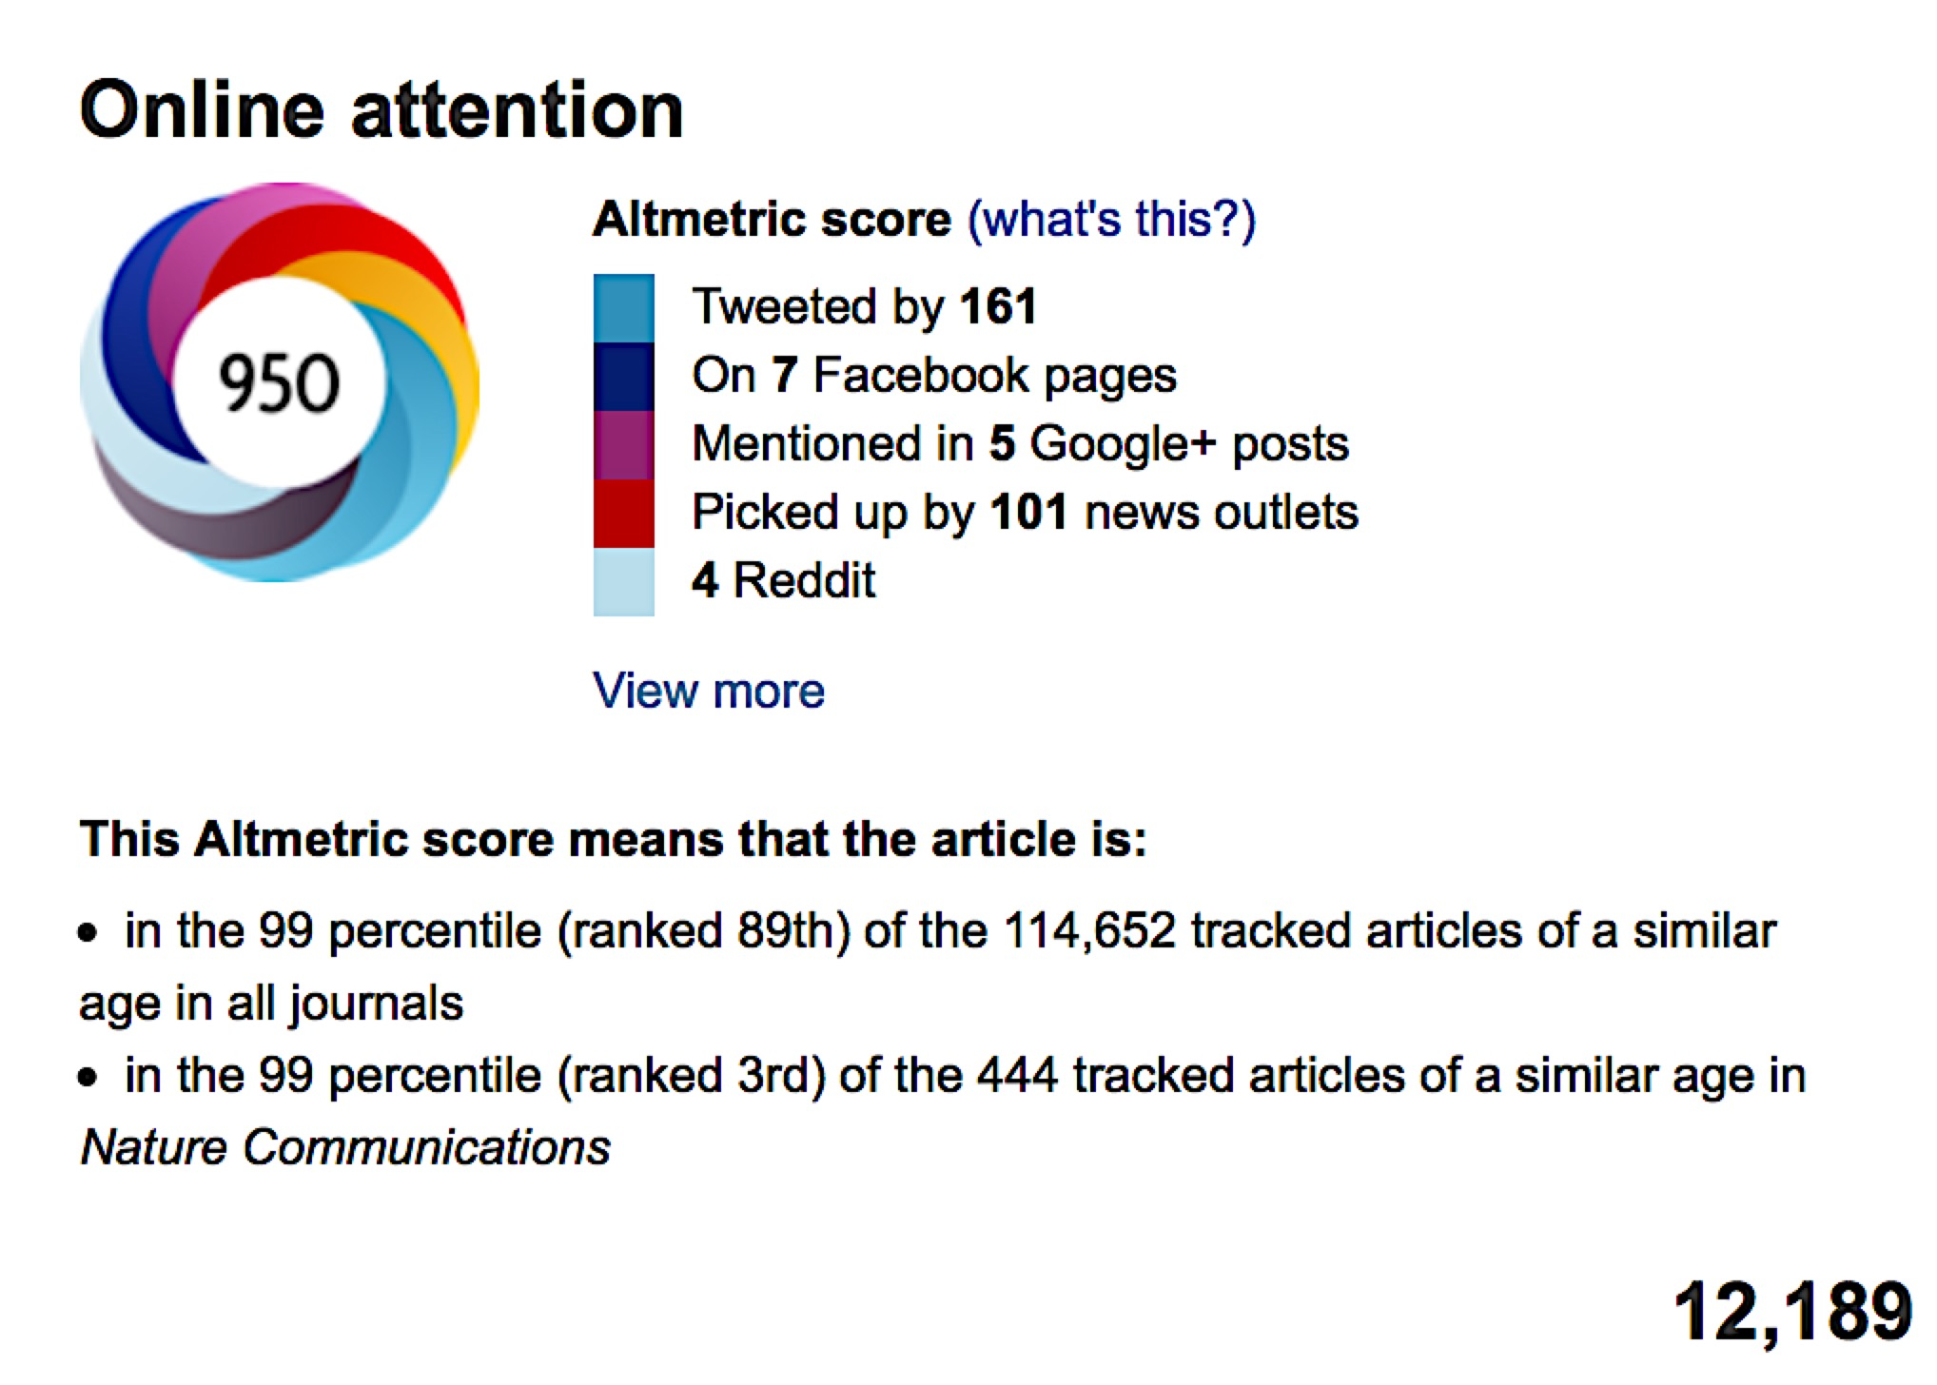
Online viewing of article

